Slide 1
Highway Safety Improvement Plan (HSIP) Implementation Plans Live Technical Assistance
05.29.2025 Webinar

Slide 2
Disclaimers
Except for any statutes or regulations cited, the contents of this presentation do not have the force and effect of law and are not meant to bind the States or the public in any way. This presentation is intended only to provide information regarding existing requirements under the law or agency policies.
The U.S. Government does not endorse products or manufacturers. Trademarks or manufacturers’ names appear in this presentation only because they are considered essential to the objective of the presentation. They are included for informational purposes only and are not intended to reflect a preference, approval, or endorsement of any one product or entity.
Unless otherwise indicated, FHWA is the source for all images in this presentation.

Slide 3
Why are we here?
Image Source: Adobe Stock Images

Slide 4
Big Picture
39,345
Source: NHTSA Early Estimate of Motor Vehicle Traffic Fatalities in 2024

Slide 5
Safety Performance Management Consequences (23 U.S.C. 148(i))
If a State does not meet or make significant progress towards meeting its safety performance targets, the State must:
Obligate HSIP funds in the amount apportioned for the prior year only for HSIP projects
Develop and submit an HSIP Implementation Plan

Slide 6
HSIP Penalty Set-Aside
State must obligate an amount equal to the Fiscal Year (FY) 22 HSIP Apportionment in FY26 only for highway safety improvement projects under 23 U.S.C. 148 (23 U.S.C. 148(i)(1))
Before post-apportionment set-asides; before penalties; before sequestration (see Table 1 of the apportionment notice for FY22, FHWA Notice N 4510.868)
Must use HSIP funds (i.e., does not include highway safety improvement projects obligated with other sources of Federal aid funds)

Slide 7
HSIP Implementation Plan Requirements (23 U.S.C. 148(i)(2))
The State must submit an implementation plan that-
(A) identifies roadway features that constitute a hazard to road users;
(B) identifies highway safety improvement projects on the basis of crash experience, crash potential, or other data-supported means;
(C) describes how highway safety improvement program funds will be allocated, including projects, activities, and strategies to be implemented;
(D) describes how the proposed projects, activities, and strategies funded under the State highway safety improvement program will allow the State to make progress toward achieving the safety performance targets of the State; and
(E) describes the actions the State will undertake to meet the safety performance targets of the State.

Slide 8
HSIP Implementation Plan Guidance
Schedule and Frequency
Decision Support Framework
Content and Structure
https://highways.dot.gov/safety/hsip/hsip-implementation-plan-guidance

Slide 9
Schedule and Frequency
May 2025
FHWA notified States of CY 2023 target assessment results
June 30, 2025*
States that did not meet or make significant progress towards their safety performance targets submit HSIP Implementation Plan to Division
Division reviews plan to ensure requirements of 23 U.S.C. 148(i)(2) are met
September 30, 2025
Division submits plan to FHWA Office of Safety
FY2026
State obligates HSIP funds consistent with plan
* SOURCE: https://highways.dot.gov/safety/hsip/hsip-implementation-plan-guidance

Slide 10
Decision Support Framework
Review fatality and serious injury trends
Review HSIP expenditures
Review historical HSIP project performance
Identify gaps or deficiencies
Identify noteworthy practices
Conduct stakeholder outreach
Develop HSIP Implementation Plan

Slide 11
Content and Structure
Available Funding
Funding Allocation Goals
HSIP Programs, Strategies and Activities
Project List
Summary of Actions

Slide 12
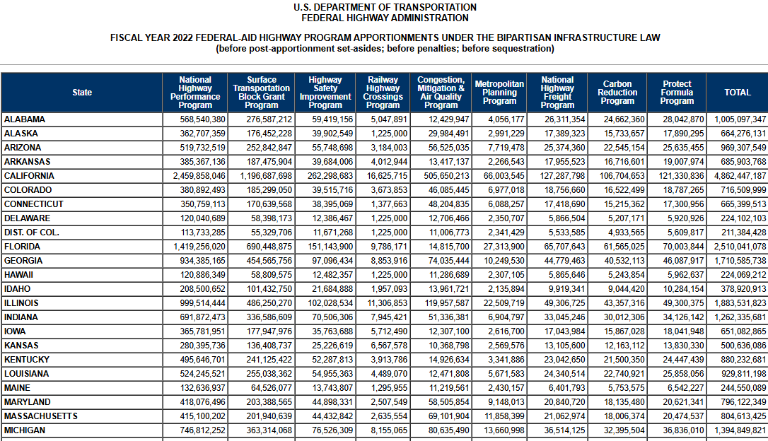
Available Funding
Source: FHWA Notice N 4510.868 Revised Fiscal Year (FY) 2022 Supplementary Tables

Slide 13
Funding Allocation Goals
Describes how funding will be allocated during the plan period.
Funding goals should be
Data-driven
Reflective of State’s safety needs

Slide 14
Funding Allocation Goals (Examples)
By Spot vs. Systemic
Hot Spot
(50%)
Systemic
(50%)
Roadway Departure
(50%)
Intersection
(36%)
Bike/Ped
(14%)
By SHSP Emphasis Area

Slide 15
HSIP Programs, Strategies and Activities (1 of 3)
Reduce Fatalities and Serious Injuries
Programs
Strategies
Activities
A Program is a group of projects (not necessarily similar in type or location) implemented to achieve a common highway safety goal.

Slide 16
HSIP Programs, Strategies and Activities (2 of 3)
Should be informed by State Strategic Highway Safety Plan (SHSP) and related planning activities
Must address:
Roadway features that constitute a hazard to road users (23 U.S.C. 148(i)(2)(A))
Highway safety improvement projects that were identified on the basis of crash potential, crash experience or other data supported means (23 U.S.C. 148(i)(2)(B))
SHSP
Programs
Strategies
Activities
Spot
Systemic

Slide 17
HSIP Programs, Strategies and Activities (3 of 3)
For each program, strategy, or activity, States should provide the following information:
Purpose
What problem does it address?
How does it relate back to the State’s SHSP?
Cost
Methodology & Implementation Plan
Description of data-driven process, including target crash type and facility type
Type of countermeasures or improvements that will be implemented
Implementation Schedule
Benefits
State must identify how the program, strategy, or activity will contribute to reducing fatalities and serious injuries (23 U.S.C. 148(b))
State must identify how the program, strategy, or activity will help make progress towards meeting safety performance targets in future years (23 U.S.C. 148(i)(2)(D))

Slide 18
Project List
Project List Template
Project Name | Project Number | Improvement Type | Project Cost | Program, Strategy or Activity | SHSP Emphasis Area | Functional Classification | Roadway Ownership
Project A
Project B
Project C
…
Example Summary Table
Program, Strategy or Activity | Estimated # Projects | Estimated Funding
Program A | 5 | $5,000,000
Strategy B | 12 | $1,200,000
Activity C | 7 | $3,800,000
Total | 24 | $10,000,000
Source: https://highways.dot.gov/safety/hsip/hsip-implementation-plan-guidance

Slide 19
Summary of Actions
The HSIP implementation plan must describe the actions the State will undertake to achieve or make significant progress towards achieving the State’s safety performance targets in subsequent years (23 U.S.C. 148(i)(2)(E))
This may include:
Summary of major program changes
SHSP updates
Statewide Transportation Improvement Plan (STIP) modifications
Coordination with other lead agencies

Slide 20
Evaluating Progress Towards Targets
Develop HSIP Implementation Plan
Projects programmed and obligated during FY 2026
Build Projects
See Results

Slide 21
Relationship to HSIP Annual Report
A Look Ahead
HSIP Annual Report (23 U.S.C. 148(h))
HSIP Implementation Plan (23 U.S.C. 148(i)(2))
A Look Back

Slide 22
Potential Practices
Include Executive Summary
Present data and analysis results in Appendix and focus plan content on takeaways and actions
Link data analysis to program needs and opportunities
Recognize HSIP is only one piece of the solution
Quantify project-level benefits
Identify safety projects that exceed minimum obligation requirement
Report progress on previous years actions

Slide 23
QUESTIONS?

Slide 24
Next Steps
HSIP Implementation Plans due by:
June 30
FHWA Division Office
Sep 30
FHWA Office of Safety

Slide 25
Contact
Office of Safety
Karen Scurry
karen.scurry@dot.gov
202-897-7168

