Slide 1

Focus Crash and Facility Type (FCFT): Practitioner Workshop
Eric Donnell
Vikash Gayah
Pennsylvania State University
Frank Gross
Thanh Le
VHB
November 3, 2021

Slide 2
Disclaimer
This presentation was created and is being presented by contractors. The views and opinions expressed in this presentation are the presenters’ and do not necessarily reflect those of the Federal Highway Administration (FHWA) or the U.S. Department of Transportation (USDOT). The contents do not necessarily reflect the official policy of the USDOT.
The U.S. Government does not endorse products or manufacturers. Trademarks or manufacturers’ names appear in this presentation only because they are considered essential to the objective of the presentation. They are included for informational purposes only and are not intended to reflect a preference, approval, or endorsement of any one product or entity.

Slide 3
Purpose of the Workshop and Learning Objectives

Slide 4
Workshop Purpose
Provide an overview of data, methods, and results of FHWA Report, Contributing Factors for Focus Crash and Facility Types (FHWA-HRT-20-052).⁽¹⁾
Identify opportunities for agency practices and future research to build on FHWA FCFT methods and findings.

Slide 5
Today’s Learning Objectives
Discover the systemic approach and its application to highway safety.
Recognize the role of data in the systemic approach.
Identify resources that can support the systemic approach.
Learn about risk factors and how they are identified and inform the systemic approach.
Share challenges and best practices with peers.

Slide 6



Workshop Icons
Information from Contributing Factors for Focus Crash and Facility Types report and quick reference guide, or The Development of Crash Modification Factors: Highway Safety Statistical Paper Synthesis report.^{(1,2,3)}
Applications and extensions of methods presented in the FHWA FCFT report.⁽¹⁾
Source: FHWA.

Slide 7

Questions?
?
Source: FHWA.
Please ask in the chat panel.

Slide 8
Workshop Outline
Present an overview of the systemic approach of FCFT.
Identify FCFTs:
  Review the FHWA FCFT study.
  Develop your own FCFTs.
Identify and evaluate risk factors:
  Provide examples from FHWA FCFT study.
  Identify agency-specific risk factors.
Screen and prioritize candidate locations.
Select countermeasures.
Hold discussions.

Slide 9
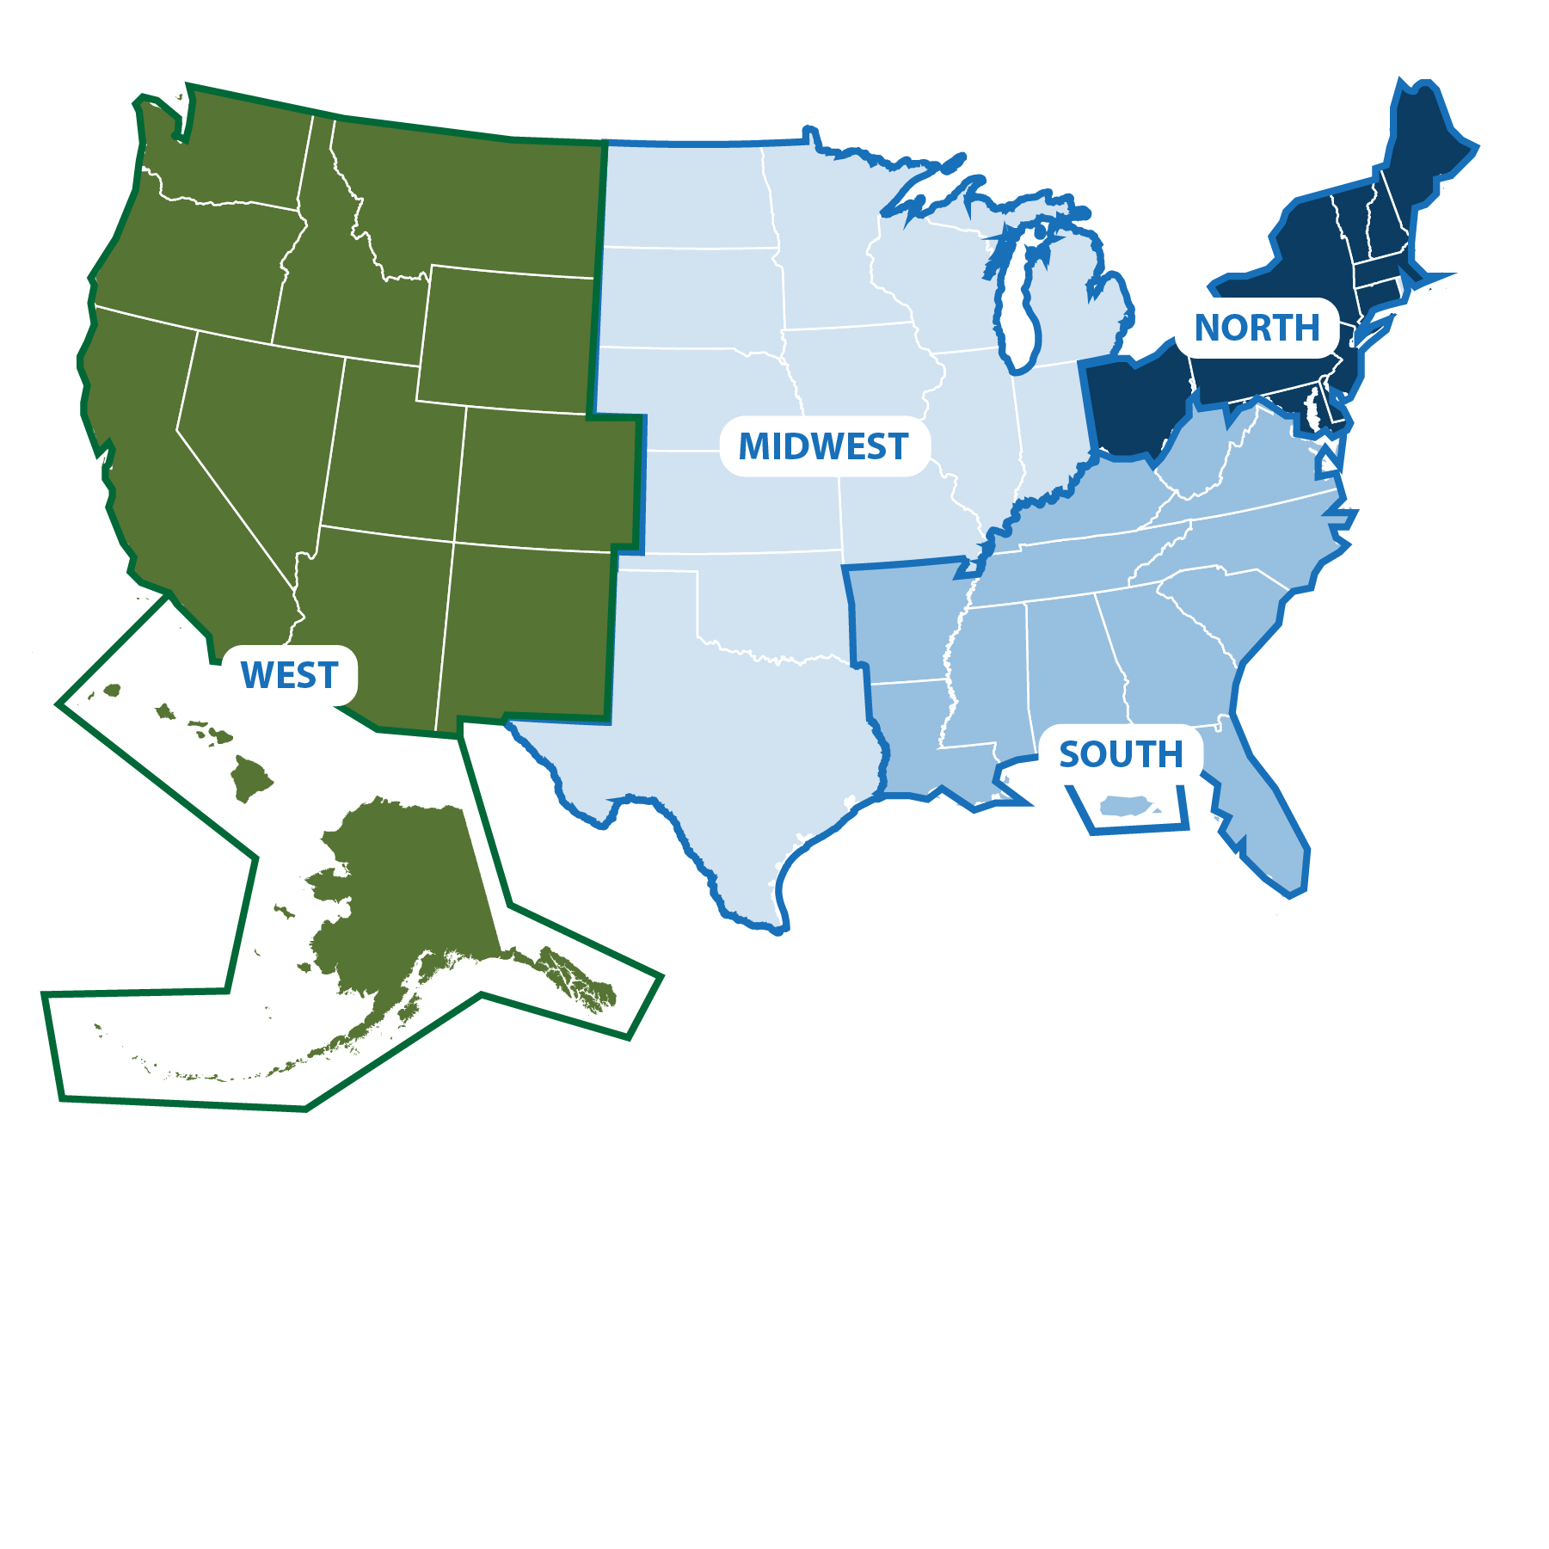

Polling Question
Q1
Source: FHWA.
From what region are you calling?
Notes:
Brief intro/engagement slide – what State are you calling in from today?
Poll: What region are you calling in from:
North
Midwest
South
West
Something else

Slide 10
Polling Question
Q2
Source: FHWA.
Does your State use the systemic approach?
Notes:
Does your State use the systemic method? Answers: Yes/No/Not sure
Plan to have specific targeted follow-up – e.g., for those agencies who don’t use systemic, would you be willing to provide explanation of the challenges/barriers or other reasons why

Slide 11
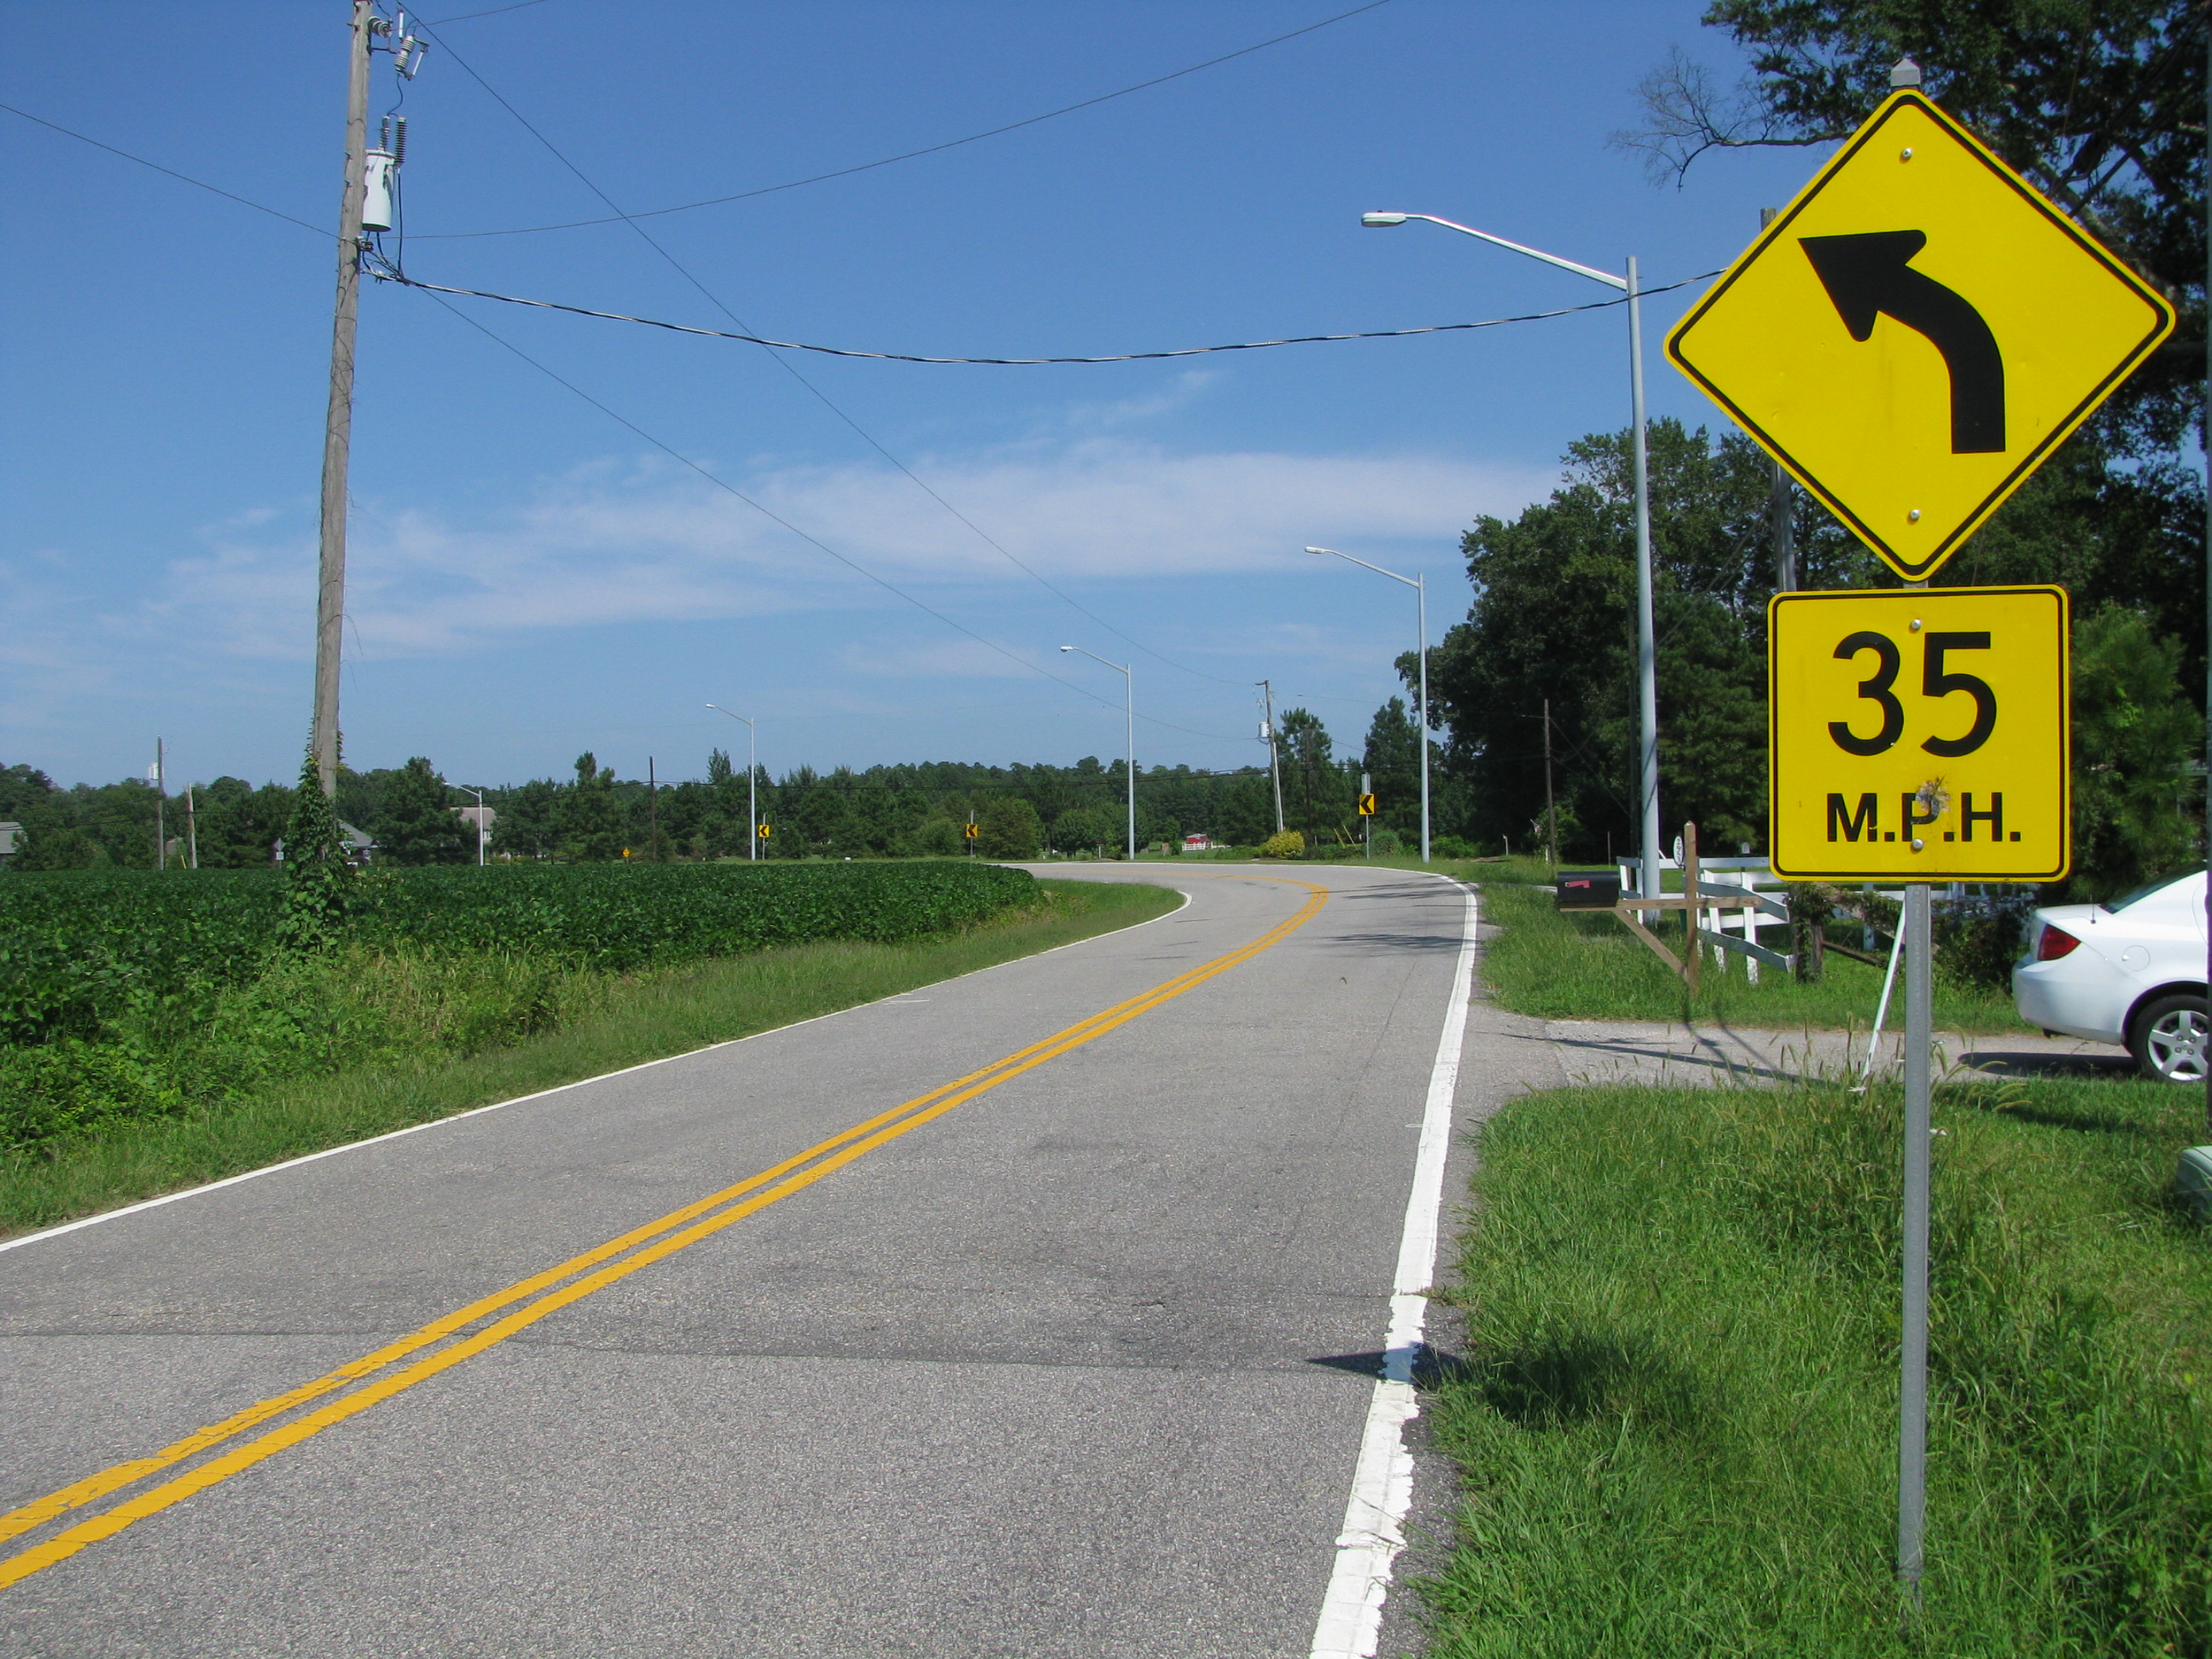
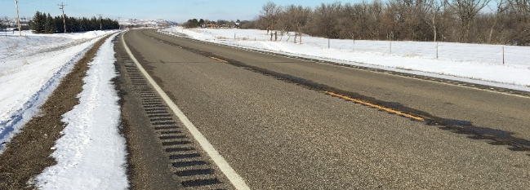
Systemic Definition
“Systemic safety improvement” means a proven safety countermeasure(s) that is widely implemented based on high-risk roadway features that are correlated with particularly severe crash types.⁽⁴⁾
All photos source: FHWA.
Systemic method identifies and proactively treats sites with certain features that are more conducive to safety problems, including sites without any problems observed yet.

Slide 12
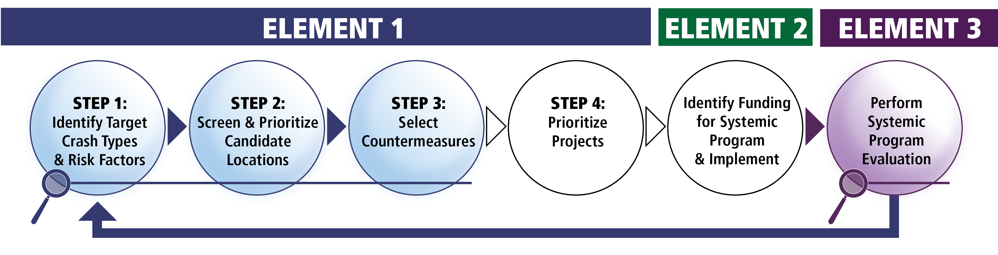
Overview of the Systemic Approach
Source: FHWA. Modified by FHWA.⁽⁵⁾

Slide 13
Polling Question
Q3
Source: FHWA.
Are you familiar with the terms focus crash type and facility type?
Notes:
Are you familiar with the term focus crash type? Yes/No/I’ve heard it before but not sure what it means

Slide 14
Polling Question
Q4
Source: FHWA.
How does your agency identify focus crash type and facility type?
Notes:
Open question for chatbox

Slide 15
Systemic Approach:
Select Focus Crash Types
What does “focus crash type” mean?
  It is a crash type that represents the greatest number of severe crashes across the roadway system of interest.
  It provides the greatest potential to reduce fatalities and severe injuries:
    Roadway departure (RwD).
    Intersection.
    Pedestrian.
    Speed.
US Fatalities by FHWA Focus Area
(FARS 2014–2016)
Source: National Highway Traffic Safety Administration (NHTSA) data. Created by FHWA.⁽⁶⁾
Ped = pedestrian; FARS = Fatality Analysis Reporting System.

Slide 16
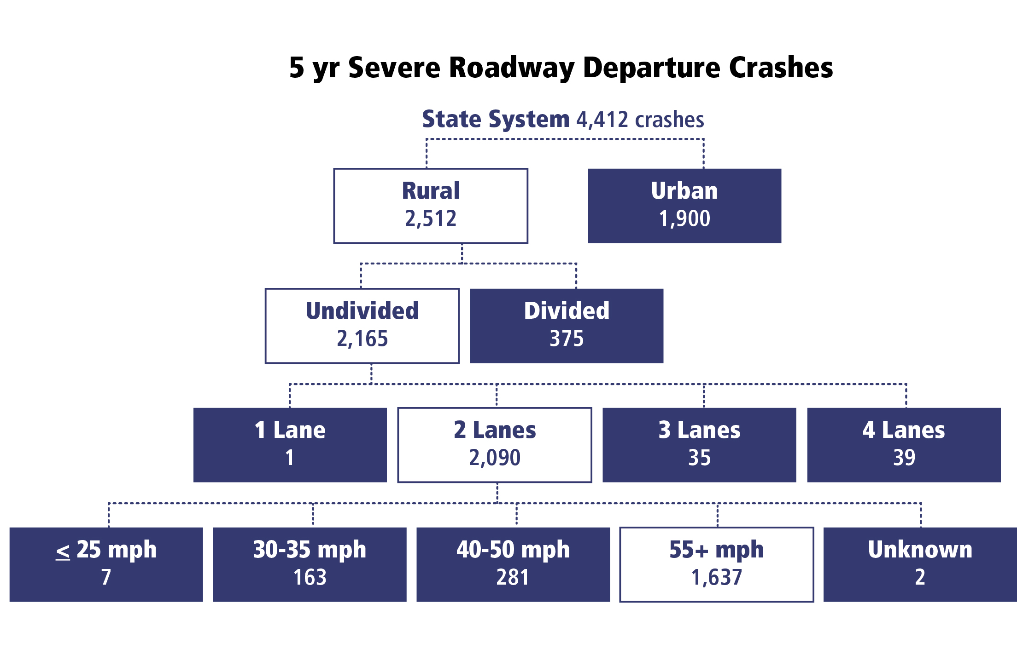
Systemic Approach: Select Focus Facilities
What does “focus facility” mean?
  A facility type where the focus crash type most frequently occurs:
    Rural, two-lane highways.
    Urban, signalized intersections.
    Horizontal curves.
    Rural, thru-stop intersections.
Source: FHWA. Modified by FHWA.⁽⁵⁾

Slide 17
FHWA FCFT Study Objectives
Select reliable and applicable data resources, statistical methodologies, analysis procedures, and tools.
Conduct data analysis to identify and validate FCFTs and their associated contributing factors.
Identify potential low-cost safety strategies that may effectively be used as systemic safety improvements.
Develop a technical report and a quick reference guide for identifying focus crash types and contributing factors.
Develop a solicitation and evaluation criteria to identify volunteer agencies to implement systemic safety improvements.

Slide 18

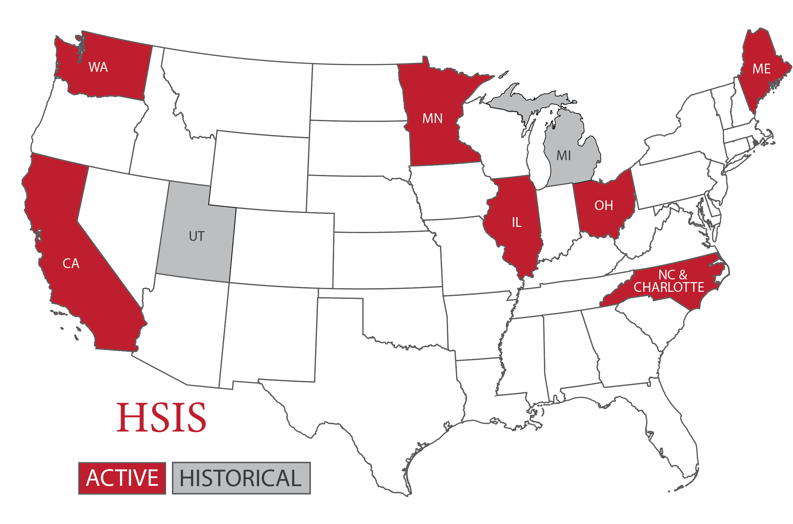
FHWA FCFT Report: Identifying FCFTs
Data sources:
FARS: 2010–2014:⁽⁶⁾
  Accident data file.
  Vehicle data file.
  Person data file.
Highway Safety Information System (HSIS):⁽⁷⁾
2009–2014 data from Washington, Ohio, California, and Minnesota:
  Accident data file.
  Roadway data file.
  Intersection data file (only needed for California).
  Curve data file (only needed for Washington).
Source: NHTSA.
Source: HSIS.⁽⁷⁾

Slide 19








FHWA FCFT Report: Identifying FCFTs
Define potential FCFTs by the various combinations of:
Crash type.
Area type
(rural or urban).
Roadway type.
Location (intersection or non-intersection).
Intersection type (four-leg or T- or Y-intersection).
Type of traffic control
(stop-controlled or signalized).
Lighting (day versus night).
Road alignment (horizontal curve versus straight/tangent).
All art source: FHWA.

Slide 20

FHWA FCFT Report: Identifying FCFTs
Rank potential FCFTs by:
  Number of fatal crashes (K).
  Fatal plus serious injury crashes (KA)
  for the HSIS States.
  Develop separate ranked lists to assess ranking consistency based on:
  FARS data.
  Data for each of the HSIS States.
Compare with the results of the process from FHWA’s Systemic
Safety Project Selection Tool.⁽⁵⁾
Source: FHWA.

Slide 21

FHWA FCFT Report: Identifying FCFTs
Example Crash Count Ranking: Potential Non-Intersection FCFTs From FARS⁽¹⁾
No. | Crash Type | Area Type | Roadway Type | Light Conditions | Road Alignment | K Crashes
1 | Fixed object | Rural | 2-lane road | Nighttime | Curve | 5,197
2 | Fixed object | Rural | 2-lane road | Daylight | Curve | 4,095
3 | Fixed object | Rural | 2-lane road | Nighttime | Straight | 4,094
4 | Fixed object | Rural | 2-lane road | Daylight | Straight | 3,825
5 | Head-on | Rural | 2-lane road | Daylight | Straight | 2,789
6 | Pedestrian | Urban | Multilane divided | Nighttime | Straight | 2,174
7 | Pedestrian | Urban | Multilane undivided | Nighttime | Straight | 2,118
8 | Pedestrian | Urban | 2-lane road | Nighttime | Straight | 2,051
9 | Pedestrian | Rural | 2-lane road | Nighttime | Straight | 1,918
10 | Angle | Rural | 2-lane road | Daylight | Straight | 1,815

Slide 22
FHWA FCFT Report: Identifying FCFTs
Example Crash Count Ranking: Potential Intersection FCFTs From FARS⁽¹⁾
No. | Crash Type | Area Type | Roadway Type | Int. Type | Traffic Control | Light Conditions | K Crashes
1 | Angle | Rural | 2-lane road | 4-leg | Stop Cntrl | Daylight | 2,424
2 | Angle | Urban | 2-lane road | 4-leg | Stop Cntrl | Daylight | 1,126
3 | Angle | Urban | Multilane divided | 4-leg | Signalized | Daylight | 977
4 | Angle | Urban | Multilane undivided | 4-leg | Signalized | Daylight | 864
5 | Angle | Rural | 2-lane road | 4-leg | Stop Cntrl | Nighttime | 750
6 | Angle | Urban | Multilane divided | 4-leg | Signalized | Nighttime | 684
7 | Angle | Rural | 2-lane road | T-Int | Stop Cntrl | Daylight | 592
8 | Pedestrian | Urban | Multilane divided | 4-leg | Signalized | Nighttime | 589
9 | Angle | Urban | Multilane undivided | 4-leg | Signalized | Nighttime | 555
10 | Angle | Urban | 2-lane road | T-Int | Stop Cntrl | Daylight | 536
T-Int = T-intersection; Cntrl = control.

Slide 23
FHWA FCFT Report: Identifying FCFTs
Example Crash Count Ranking: Potential Non-Intersection FCFTs From HSIS Ohio Data (by KA Crashes)⁽¹⁾
No. | Crash Type | Area Type | Roadway Type | Light Conditions | Road Alignment | KA Crashes
1 | Fixed object | Rural | 2-lane roads | Daylight | Straight | 1,027
2 | Fixed object | Rural | 2-lane roads | Nighttime | Straight | 792
3 | Fixed object | Rural | 2-lane roads | Daylight | Curve | 773
4 | Fixed object | Urban | Freeways | Daylight | Straight | 590
5 | Fixed object | Rural | 2-lane roads | Nighttime | Curve | 569
6 | Rear end | Urban | Freeways | Daylight | Straight | 565
7 | Fixed object | Urban | Freeways | Nighttime | Straight | 522
8 | Rear end | Rural | 2-lane roads | Daylight | Straight | 409
9 | Sideswipe—meeting | Rural | 2-lane roads | Daylight | Straight | 391
10 | Sideswipe—passing | Urban | Freeways | Daylight | Straight | 348

Slide 24
FHWA FCFT Report: Identifying FCFTs
Example Crash Count Ranking: Potential Intersection FCFTs From HSIS Ohio Data (by KA Crashes)⁽¹⁾
No. | Crash Type | Area Type | Roadway Type | Location Type | Light Conditions | K Crashes | KA Crashes
1 | Angle | Rural | 2-lane roads | Intersection | Daylight | 153 | 1,152
2 | Angle | Urban | Multilane undivided | Intersection | Daylight | 29 | 657
3 | Angle | Urban | Multilane divided | Intersection | Daylight | 33 | 511
4 | Rear end | Urban | Multilane undivided | Intersection | Daylight | 10 | 338
5 | Angle | Rural | 2-lane roads | Intersection | Nighttime | 48 | 296
6 | Angle | Urban | Multilane divided | Intersection | Daylight | 27 | 243
7 | Rear end | Urban | 2-lane roads | Intersection | Daylight | 5 | 243
8 | Angle | Urban | Multilane undivided | Intersection | Nighttime | 10 | 242
9 | Angle | Rural | 2-lane roads | Intersection | Daylight | 25 | 213
10 | Rear end | Rural | 2-lane roads | Intersection | Daylight | 13 | 205

Slide 25
FHWA FCFT Report: Identifying FCFTs
List of Non-Intersection FCFTs
Run-off-road (ROR) crashes on rural two-lane roads on horizontal curves (daytime and nighttime).
ROR crashes on rural two-lane roads on straight segments (daytime and nighttime).
Lane-departure crashes on rural two-lane roads on horizontal curves (daytime and nighttime).
Lane-departure crashes on rural two-lane roads on straight segments (daytime and nighttime).
Head-on crashes on rural two-lane roads on horizontal curves (daytime and nighttime).
Head-on crashes on rural two-lane roads on straight segments (daytime and nighttime).
Rollover crashes on rural two-lane roads on straight segments (daytime and nighttime).
Rollover crashes on rural two-lane roads on horizontal curves (daytime and nighttime).
Angle crashes on rural two-lane roads on straight segments (daytime).

Slide 26
FHWA FCFT Report: Identifying FCFTs
List of Intersection FCFTs
  Angle crashes on rural two-lane roads at four-leg stop-controlled intersections (daytime and nighttime).
  Angle crashes on urban two-lane roads at four-leg stop-controlled intersections (daytime).
  Angle crashes on urban multilane divided roads at four-leg signalized intersections (daytime).
  Angle crashes on urban multilane undivided roads at four-leg signalized intersections (daytime).
  Angle crashes on rural two-lane roads at three-leg stop-controlled intersections (daytime).
  Angle crashes on rural multilane divided roads at four-leg minor-road stop-controlled intersections (daytime).

Slide 27
FHWA FCFT Report: Identifying FCFTs
Non-Intersection FCFTs on Rural, Two-Lane Roads
Crash Type | Conditions
Crash Type | Horizontal Curve | Straight | Daylight | Nighttime
ROR |  | ✓ | ✓ | ✓
 | ✓ |  | ✓ | ✓
Lane Departure |  | ✓ | ✓ | ✓
 | ✓ |  | ✓ | ✓
Head-on |  | ✓ | ✓ | ✓
 | ✓ |  | ✓ | ✓
Angle |  | ✓ | ✓
Rollover/Overturn |  | ✓ | ✓ | ✓
 | ✓ |  | ✓ | ✓
✓ = conditions that defined focus crash types.

Slide 28
FHWA FCFT Report: Identifying FCFTs
Intersection FCFTs
Crash Type | Conditions
Crash Type | Urban | Rural | Two-Lane | Multilane Divided | Multilane Undivided | 4-Leg | 3-Leg | Stop Controlled | Signalized | Daylight | Nighttime
Angle |  | ✓ | ✓ |  |  | ✓ |  | ✓ |  | ✓ | ✓
 | ✓ |  | ✓ |  |  | ✓ |  | ✓ |  | ✓
 | ✓ |  |  | ✓ |  | ✓ |  |  | ✓ | ✓
 | ✓ |  |  |  | ✓ | ✓ |  |  | ✓ | ✓
 |  | ✓ | ✓ |  |  |  | ✓ | ✓ |  | ✓
 |  | ✓ |  | ✓ |  | ✓ |  | ✓ Minor road |  | ✓
✓ = conditions that defined focus crash types.

Slide 29

FHWA FCFT Report: Identifying FCFTs
Results: Pedestrian FCFTs (information from related published literature):
  All types of pedestrian crashes at
  intersections.
  Pedestrian crashes at intersections
  involving a crossing pedestrian and a
  vehicle going straight.
Source: FHWA.

Slide 30


Developing Agency-Specific FCFTs
Compile data.
  Use data from crash reports. OR
  Combine crash data with roadway inventory and other data sources.
Analyze data to identify crash and facilities types.
Source: FHWA.

Slide 31

Data Sources
Roadway inventory data—Typically maintained by State and local agencies:
  Facility type.
  Number of lanes.
  Cross-sectional elements.
  Traffic control and speed limit.
Traffic data—Typically maintained by State and local agencies, although some manual counts may be needed:
  Traffic volume.
  Nonmotorized user exposure.
  Traffic composition.
Crash data—Typically maintained by State agencies:
  Number of crashes by type.
  Number of crashes by severity.
All art source: FHWA.

Slide 32
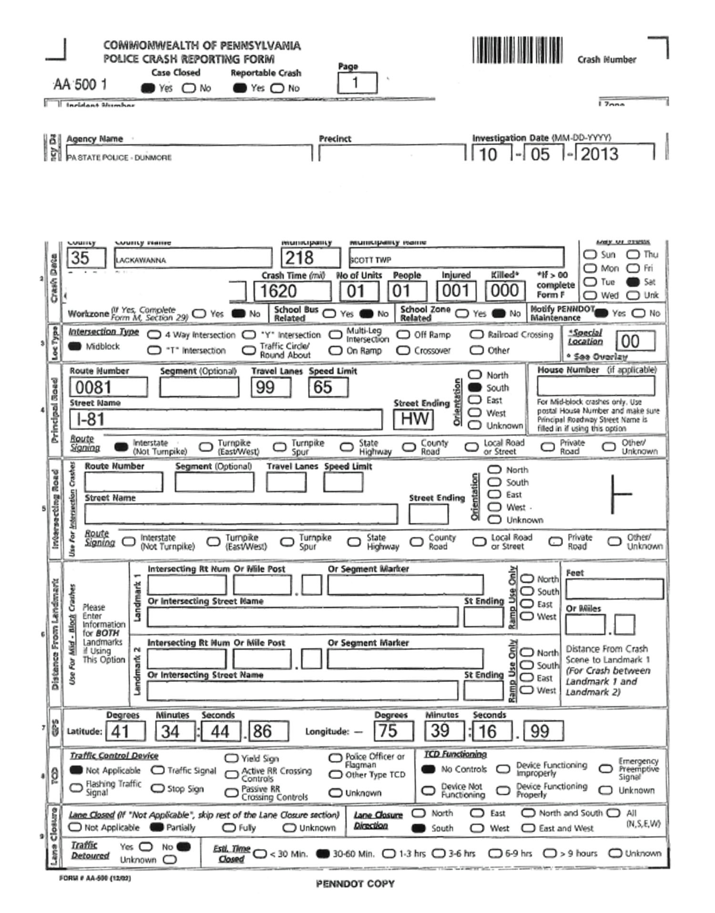
Option 1: Using Crash Reports
Relevant data fields:
  Intersection type.
  Roadway type.
  Traffic control device.
  Crash type.
  Speed limit.
  Illumination type.
  Indicators for:
    Work zone.
    School bus/zone related.
Source: FHWA.

Slide 33
Option 2: Merging Data
Data sources and information are needed as follows:
  Roadway inventory data:
    Facility type.
    Number of lanes.
    Cross-sectional elements.
    Traffic control and speed limit.
  Traffic data:
    Traffic volume.
    Nonmotorized user exposure.
    Traffic composition.
  Crash data:
    Number of crashes by type.
    Number of crashes by severity.
Analysis database must be developed to identify FCFTs.
Each “row” or observation should represent a single crash that was observed.
Each crash observation should be linked to the roadway and traffic characteristics based on where the crash occurred—The linear referencing system can be used.

Slide 34
Polling Question
Q5
Source: FHWA.
Are you familiar with a linear referencing system?
Notes:
Are you familiar with a linear referencing system?
-Yes, I use if often
-Yes, but it’s not something I typically work with
-No, I’ve never heard this term before
-Not sure, I’ve heard this term but not sure what it means

Slide 35
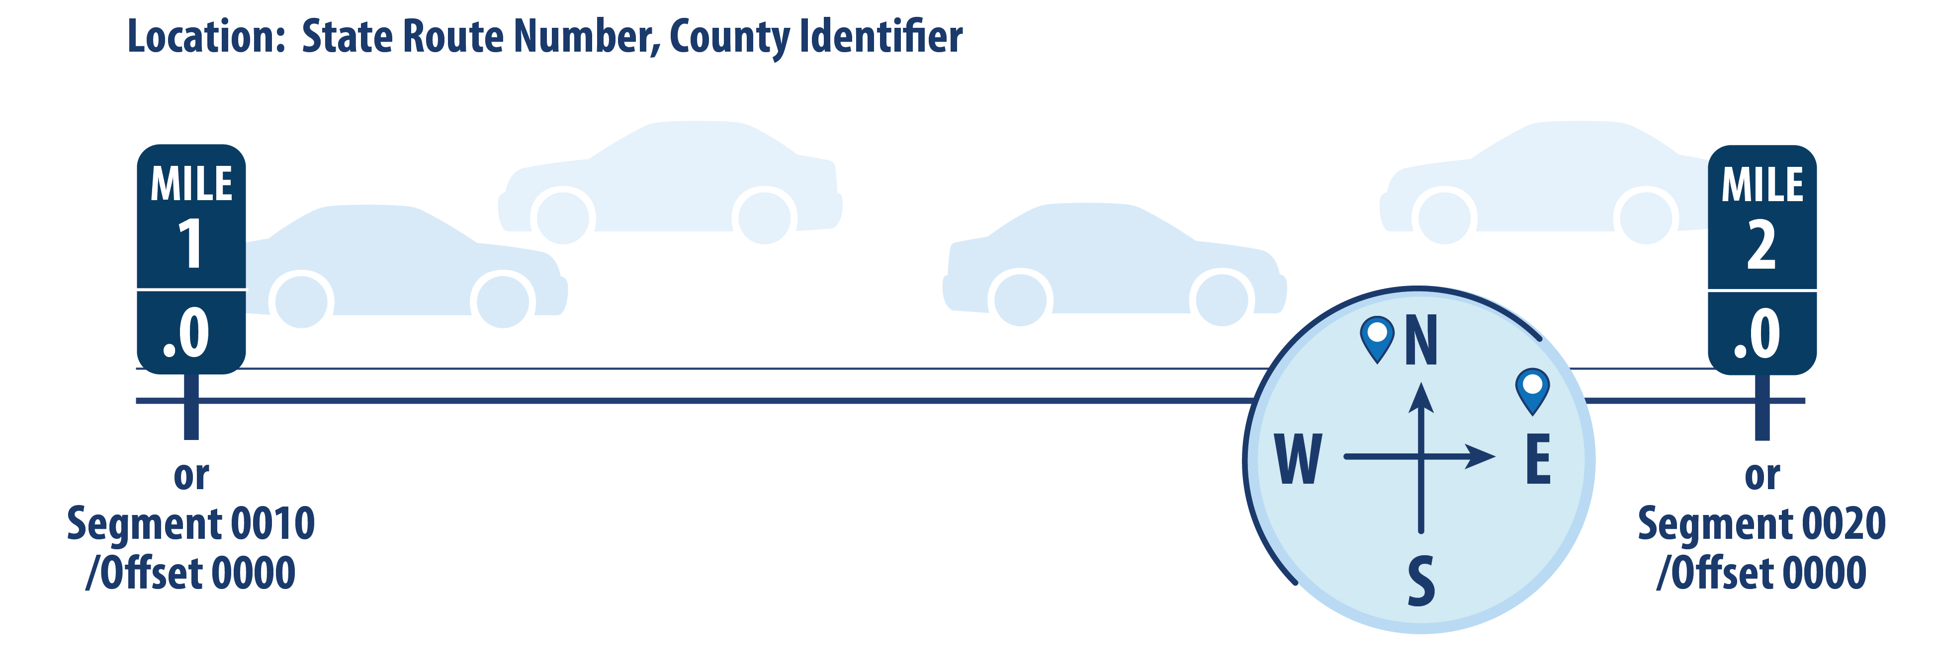
What Is a Linear Referencing System?
Source: FHWA.

Slide 36

Merging Crash and Roadway Data for FCFT Identification
Road Log File
County | Route | Beg_MP | End_MP | Lanes | Lane Width | Shld Width
12 | 322 | 0 | 1.25 | 2 | 12 | 6
12 | 322 | 1.25 | 2.45 | 4 | 11 | 8
12 | 322 | 2.45 | 3.05 | 4 | 12 | 6
12 | 322 | 3.05 | 4.03 | 4 | 11 | 6
Crash File
Crash ID | County | Route | MP | Severity
654 | 12 | 322 | 1.75 | 4
4556 | 12 | 322 | 3.35 | 5
5426 | 12 | 322 | 0.75 | 3
6241 | 12 | 322 | 2.65 | 3
7412 | 12 | 322 | 2.85 | 4
8641 | 12 | 322 | 3.75 | 5
9715 | 12 | 322 | 0.65 | 3
What were the roadway and traffic characteristics associated with each crash?
Beg = beginning; MP = milepost; Shld = shoulder; ID = identification.

Slide 37
Merging Crash and Roadway Data for FCFT Identification
Road Log File
County | Route | Beg_MP | End_MP | Lanes | Lane Width | Shld Width
12 | 322 | 0 | 1.25 | 2 | 12 | 6
12 | 322 | 1.25 | 2.45 | 4 | 11 | 8
12 | 322 | 2.45 | 3.05 | 4 | 12 | 6
12 | 322 | 3.05 | 4.03 | 4 | 11 | 6
Crash File
Crash ID | County | Route | MP | Severity
654 | 12 | 322 | 1.75 | 4
4556 | 12 | 322 | 3.35 | 5
5426 | 12 | 322 | 0.75 | 3
6241 | 12 | 322 | 2.65 | 3
7412 | 12 | 322 | 2.85 | 4
8641 | 12 | 322 | 3.75 | 5
9715 | 12 | 322 | 0.65 | 3
Crash ID | County | Route | MP | Severity | Lanes | Lane Width | Shld Width
654 | 12 | 322 | 1.75 | 4 | 4 | 11 | 8
4556 | 12 | 322 | 3.35 | 5 | 4 | 11 | 6
5426 | 12 | 322 | 0.75 | 3 | 2 | 12 | 6
6241 | 12 | 322 | 2.65 | 3 | 4 | 12 | 6
7412 | 12 | 322 | 2.85 | 4 | 4 | 12 | 6
8641 | 12 | 322 | 3.75 | 5 | 4 | 11 | 6
9715 | 12 | 322 | 0.65 | 3 | 2 | 12 | 6
Notes:
VG question: Do we want to make up another data example where roadway features changed? That might be more helpful to demonstrate the “merge” required in this case?

Slide 38
Exercise: Identify FCFTs
Notes:
Conduct a live exercise using real data. Create crash tree from data and ask participants to identify FCFTs

Slide 39
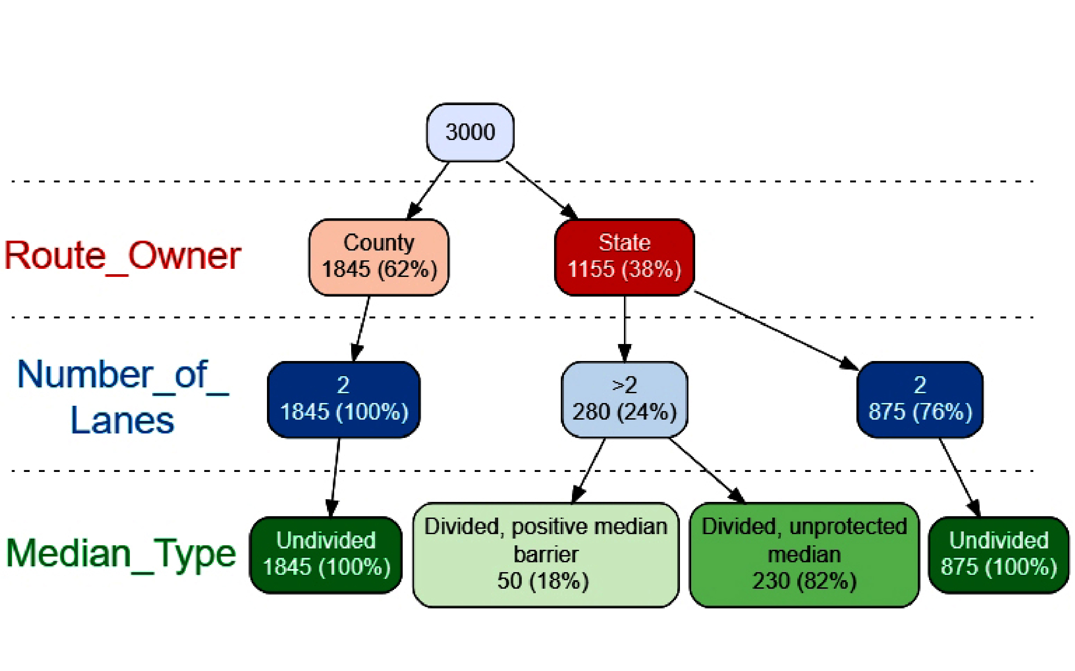
Exercise: Identify FCFTs From Crash Tree
Generate crash tree from data.
Identify FCFTs.
Source: FHWA.
Crash tree generated using R⁽⁸⁾ and vtree package.⁽⁹⁾
Notes:
Conduct a live exercise using real data. Create crash tree from data and ask participants to identify FCFTs

Slide 40
Polling Question
Q6
Source: FHWA.
What are FCFTs in your State (e.g., from similar analyses, from Strategic Highway Safety Plan (SHSP), from other strategic program efforts)?
Notes:
Open questions for chatbox

Slide 41

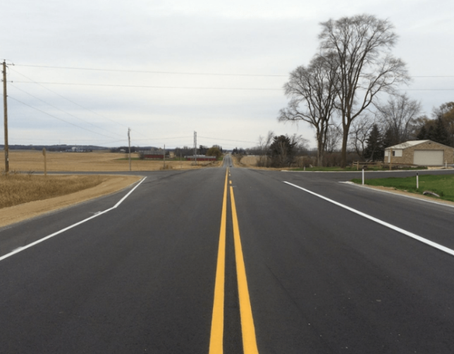
Systemic Approach: Identify and Evaluate Risk Factors
What does “risk factor” mean?
  A representation of risk in terms of the characteristics associated with locations where targeted crash types occurred:
    Traffic volume.
    Roadway geometry (number of lanes, lane width, curvature).
    Traffic operations (speed, traffic control, signs, markings).
    Roadside design (clear zone, sight distance).
All photos source: FHWA.

Slide 42
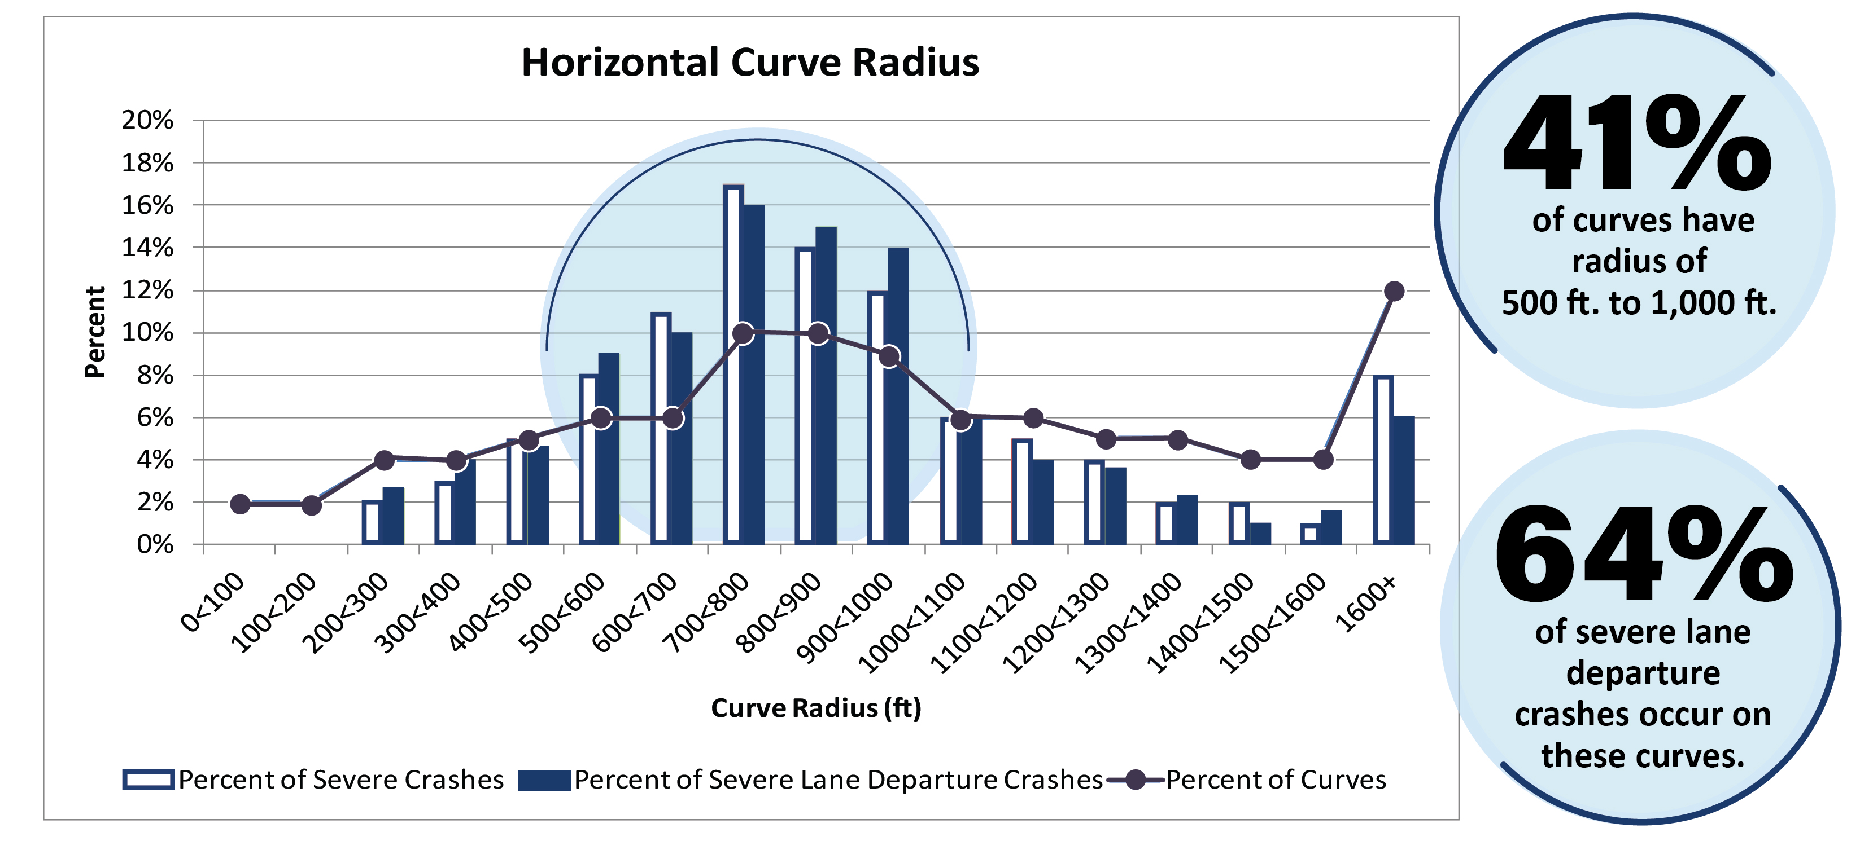
Systemic Approach: Identify and Evaluate Risk Factors
Source: FHWA.

Slide 43
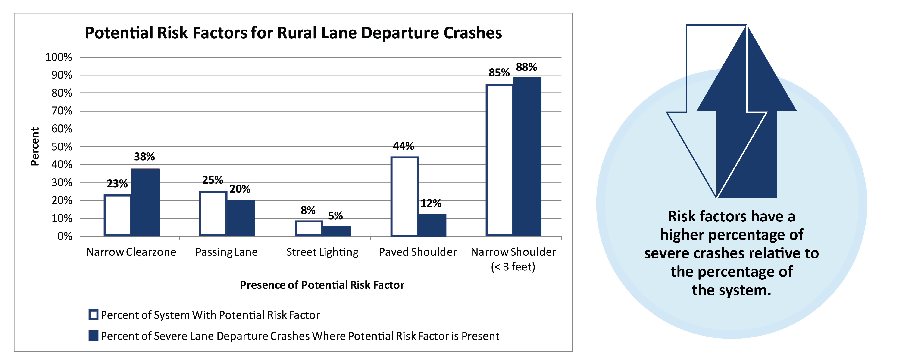
Systemic Approach: Identify and Evaluate Risk Factors
Source: FHWA.

Slide 44

FHWA FCFT Report: Risk Factors
Three States:
  California and Ohio data for non-intersection
  crashes.
  Washington and Ohio data for intersection
  crashes.
Data sources:
  Roadway and traffic data from HSIS.
  Climate data from National Oceanic and Atmospheric Administration.
  Socioeconomic data from U.S. Census Bureau.
Source: FHWA.

Slide 45




FHWA FCFT Report: Risk Factors
Integrate data from different sources:
  Designate plot study locations for each State:
    Intersections.
    Curve segments.
    Tangent segments.
  Join climate data:
    Use nearest weather station.
    Base on straight line distance.
  Join census data:
    Use census block containing study site.
    Use the midpoint for roadway segment.
All art source: FHWA.

Slide 46
FHWA FCFT Report: Risk Factors
Potential contributing factors defined by three categories:
  Roadway.
  Climate.
  Census.
  Philosophy of causation or causal inference not implied:
  Some could be direct contributing factors.
  Others may be surrogates for other characteristics.
  Consistency considered:
  Across subsets of related FCFTs.
  Across multiple States.
  With previous findings in the literature.

Slide 47

FHWA FCFT Report:
Roadway Risk Factors
  Annual average daily traffic (AADT) (average, mainline/major, cross street/minor).
  Segment length.
  Curve radius.
  Percent grade.
  Grade type.
  Shoulder type.
  Terrain.
  Speed limit.
  Width (lane, shoulder, median, and surface).
  Truck percentages.
  Mainline left-/right-turn channelization.
  Cross-street left-/right-turn channelization.
  Number of approaches with
  left-/right-turn lanes.

Slide 48



FHWA FCFT Report:
Climate Risk Factors
Potential climate contributing factors:
All art source: FHWA.
  Average annual snowfall totals.
  Average annual rainfall totals.
  Average annual maximum and minimum temperatures.
  Average annual winter minimum temperatures.
  Average annual number of days with temperature ≤32℉.

Slide 49
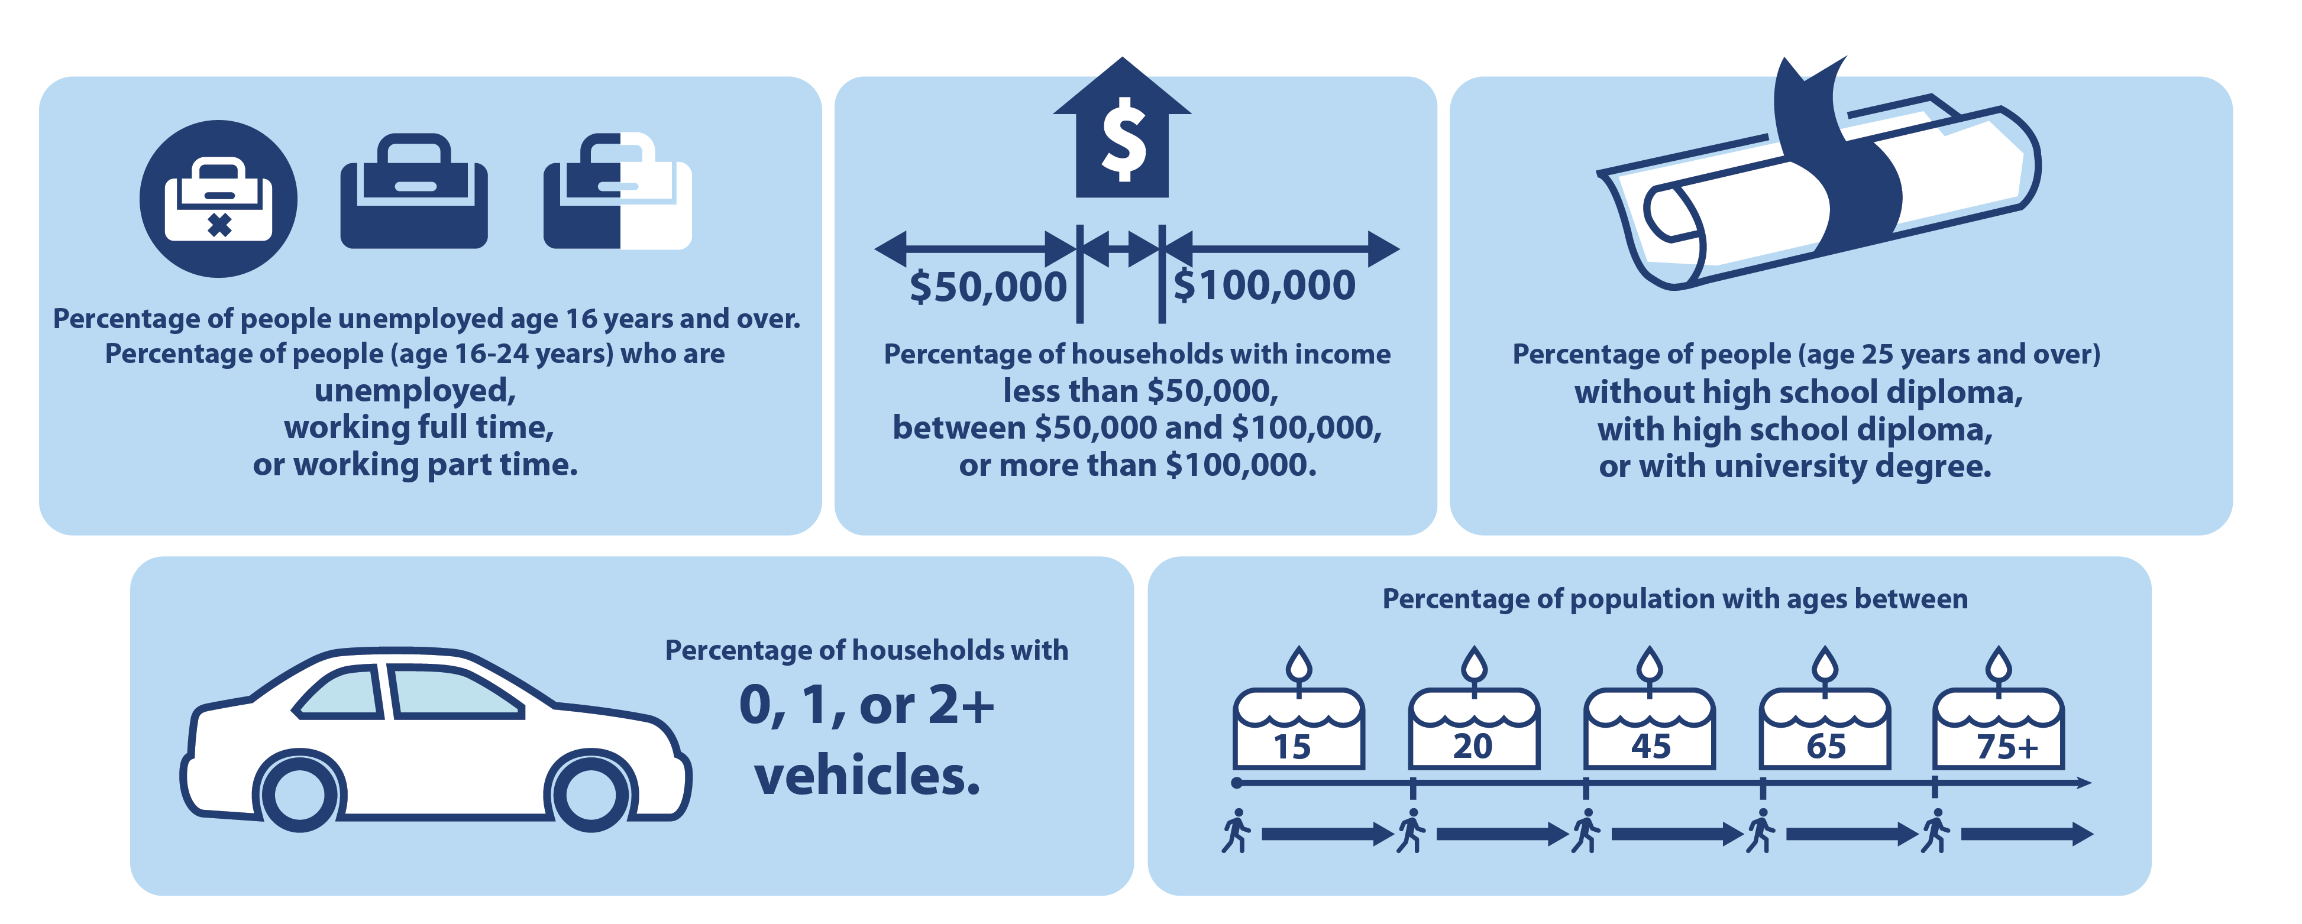
FHWA FCFT Report: Socioeconomic Risk Factors
Source: FHWA.

Slide 50
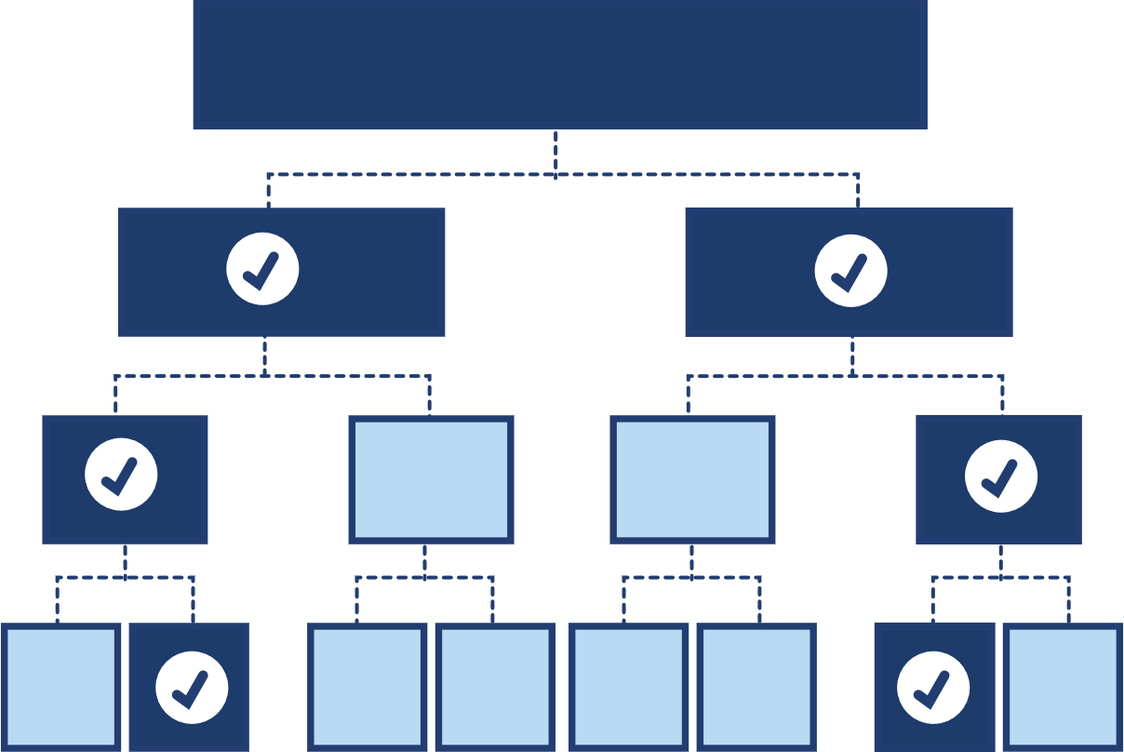
FHWA FCFT Report: Identify Risk Factors
Methodology of random forest:
  Tree-based machine-learning
  algorithm:
    Binary tree mapping a response variable and explanatory variables.
    Output in the form of a tree showing the predictive splits.
  Multiple trees to form a random forest:
    Aggregated results.
    Random forest plots: displaying the increase in MSE with removal of a variable.
    Most influential variables indicated.
Source: FHWA.

Slide 51
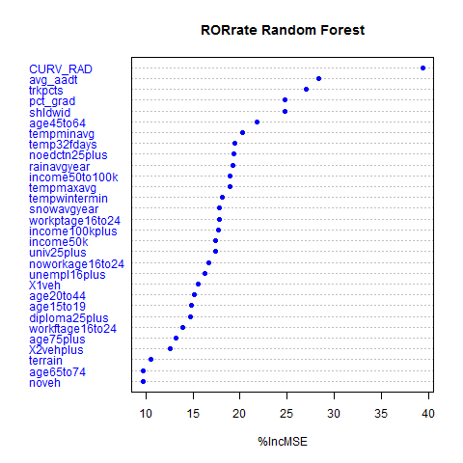
FHWA FCFT Report: Identify Risk Factors
Use the random forest algorithm to identify the strongest predictors (highest percent increase in MSE).
  Example: ROR crashes on rural two-lane horizontal curves.
%IncMSE = percent increase in MSE.
Source: FHWA.⁽¹⁾

Slide 52
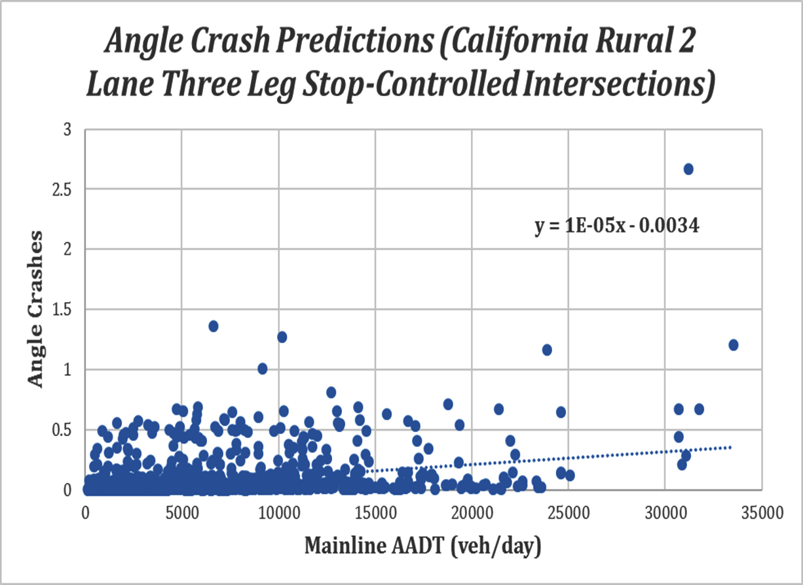
FHWA FCFT Report: Identify Risk Factors
Determine the direction of the relationship between the outcome variable (e.g., crash frequency) and each predictor:
  Plots of random forest predicted crash.
  Example: Angle crashes versus mainline AADT.
Source: FHWA.⁽¹⁾

Slide 53
FHWA FCFT Report: Identify Risk Factors
Contributing Factors for Daytime, ROR Crashes That Resulted in Fatal, Incapacitating, or Non‐Incapacitating Injury (ROR-KAB-D) on Rural, Two-Lane Tangent Sections: Washington State⁽¹⁾
Variable | Impact on Crash Frequency Predictions
Percent Grade | Increases
Average AADT | Increases
Truck Percentage | Decreases
Average Shoulder Width | Decreases
Average Annual Rainfall Total | Increases
Percentage of Population (Ages 20–44 yr) | Increases
Percentage of People (Ages 16–24 yr) Unemployed | Increases
Annual Average Maximum Temperature | Decreases
Percentage of Population (Ages 25+ yr) with High School Diploma (But No University Degree) | Decreases
Percentage of Population (Ages 25+ yr) without High School Diploma | Decreases

Slide 54
FHWA FCFT Report: Identify Risk Factors
Contributing Factors for Nighttime, Head-on Crashes That Resulted in Fatal, Incapacitating, or Non‐Incapacitating Injury (HEO-KAB-N) on Rural, Two-Lane Horizontal Curves: Washington State⁽¹⁾
Variable | Impact on Crash Frequency Predictions
Percentage of Population (Ages 15–19 yr) | Increases
Truck Percentage | Decreases
Average AADT | Increases
Percentage of Population (Ages 25+ yr) with High School Diploma (But No University Degree) | Decreases
Average Shoulder Width | Increases
Percentage of People (Ages 16–24 yr) Working Part Time | Decreases
Percentage of Households with One Vehicle | Decreases
Percentage of Households with Income > $100,000 | Increases
Annual Average Maximum Temperature | Decreases
Percentage of Population (Ages 65–74 yr) | Decreases

Slide 55
FHWA FCFT Report: Identify Risk Factors
Contributing Factors for Daytime, Angle Crashes That Resulted in Fatal, Incapacitating, or Non‐Incapacitating Injury (ANG-KAB-D) on Rural, Two-Lane Horizontal Curves and Tangent Sections: Ohio⁽¹⁾
Variable | Impact on Crash Frequency Predictions
Percent Grade | Decreases
Average AADT | Increases
Percentage of Population (Ages 25+ yr) with University Degree | Increases
Percentage of Households with Income > $100,000 | Increases
Percentage of Population (Ages 25+ yr) without High School Diploma | Increases
Percentage of Population (Ages 45–64 yr) | Decreases
Surface Width | Increases
Percentage of Population (Ages 25+ yr) with High School Diploma (But No University Degree) | Decreases
Percentage of Population (Ages 20–44 yr) | Increases
Percentage of Population (Ages 75+ yr) | Decreases

Slide 56
FHWA FCFT Report: Identify Risk Factors
Contributing Factors for Daytime, Angle Crashes That Resulted in Fatal, Incapacitating, or Non-Incapacitating Injury (ANG-KAB-D) at Four-Leg Signalized Intersections on Urban, Multilane Divided Roads: California⁽¹⁾
Variable | Impact on Crash Frequency Predictions
Average Annual Rainfall Total | Decreases
Percentage of Households with Income < $50,000 | Increases
Annual Average Winter Minimum Temperature | Decreases
Annual Average Minimum Temperature | Decreases
Annual Average Number of Days with Minimum Temperature ≤ 32℉ | Decreases
Design Speed | Increases
Lane Width | Increases
Percentage of Population (Ages 75+ yr) | Increases
Mainline AADT | Increases
Median Width | Increases

Slide 57
FHWA FCFT Report: Identify Risk Factors
Contributing Factors for Daytime, Angle Crashes That Resulted in Fatal, Incapacitating, or Non-Incapacitating Injury (ANG-KAB-D) at Four-Leg Stop Controlled Intersections on Rural, Multilane Divided Roads: Ohio⁽¹⁾
Variable | Impact on Crash Frequency Predictions
Speed Limit | Decreases
Mainline AADT | Increases
Cross Street AADT | Decreases
Average Annual Snowfall Total | Increases
Annual Average Maximum Temperature | Decreases
Percentage of Households with Income between $50,000 and $100,000 | Decreases
Average Annual Rainfall Total | Increases
Percentage of Households with Income > $100,000 | Increases
Percentage of People (Ages 16–24 yr) Unemployed | Increases
Percentage of Population (Ages 25+ yr) with University Degree | Decreases

Slide 58
Questions
Q7
Do you see anything missing from this list of risk factors?
What are advantages and challenges of weather and socioeconomic factors?
Risk Factors for ROR-KAB-D on Rural, Two-Lane Tangent Road in Washington State
Average AADT
Truck Percentage
Average Shoulder Width
Average Annual Rainfall Total
Percentage of Population (Ages 20–44 yr)
Percentage of People (Ages 16–24 yr) Unemployed
Annual Average Maximum Temperature
Percentage of Population (Ages 25+ yr) with High School Diploma (But No University Degree)
Percentage of Population (Ages 25+ yr) without High School Diploma
Source: FHWA.
Notes:
Open questions for chatbox

Slide 59
What Have We Covered?
Overview of the systemic approach.
Focus crash facility types:
  Overview of FHWA FCFT study.
  Development of agency-specific FCFTs.
Risk factors:
  Identify and evaluate risk factors.
  Summarize FHWA FCFT study findings.
  After a 15-min break, a live demonstration/exercise:
  Risk factor identification using random forest.
Notes:
Conduct a live exercise using real data

Slide 60

Break
Source: FHWA.
15 min

Slide 61
Exercise: Identify Risk Factors
Notes:
Conduct a live exercise using real data. Run Random Forest model and ask participants to identify FCFTs

Slide 62
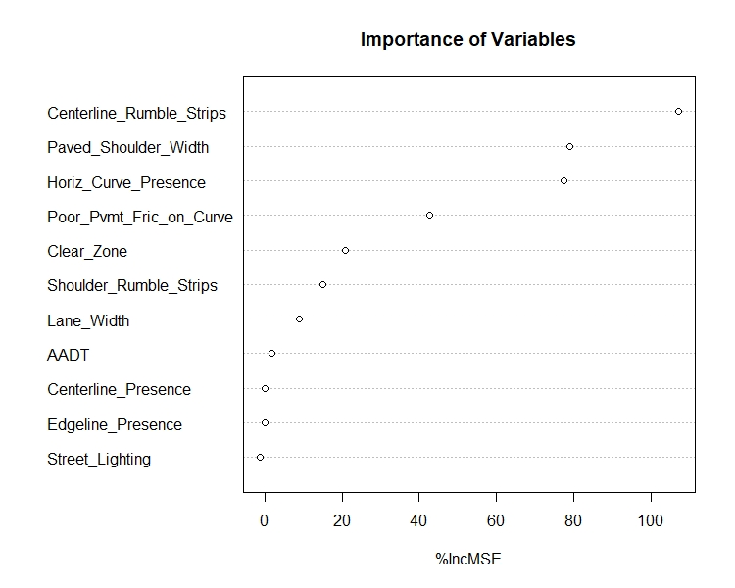
Exercise: Identify Risk Factors
Run random forest model.
Generate variable importance chart.
Identify risk factors.
Model generated using R⁽⁸⁾ and randomForest package.⁽¹⁰⁾
Source: FHWA.
Notes:
Conduct a live exercise using real data. Run Random Forest model and ask participants to identify FCFTs

Slide 63

Quantifying Agency-Specific Risk Factors
Compile data.
Analyze data to quantify
risk factors.
Source: FHWA.

Slide 64
Data Sources
Roadway inventory data—Typically maintained by State and local agencies:
  Facility type.
  Number of lanes.
  Cross-sectional elements.
  Traffic control and speed limit.
Traffic data—Typically maintained by State and local agencies, although some manual counts may be needed:
  Traffic volume.
  Nonmotorized user exposure.
  Traffic composition.
Crash data—Typically maintained by State agencies:
  Number of crashes by type.
  Number of crashes by severity.
All art source: FHWA.

Slide 65

Linking Data
Analysis database represents individual roadway segments/intersections of interest that were identified as an FCFT.
Each “row” or observation should represent a roadway element.
Crashes should be assigned to each roadway element—A linear referencing system can be used.
All art source: FHWA.

Slide 66
Merging Roadway and Crash Data
Use the linear referencing system:
  Find county, route, and MP.
  Start with the road log file as the “base” and append the crash data (must account for segments or intersections with “zero” crash frequency).
Road Log File
Accident File
How many crashes per segment?
Source: HSIS.⁽⁷⁾

Slide 67
Data Merge Solution
County-Route | Begin MP | End MP | Number of Crashes
0030000049 | 0 | 0.251 | 0*
0030000049 | 0.251 | 1.42 | 1
0030000049 | 1.42 | 2.03 | 4
0030000049 | 2.03 | 2.13 | 0*
0030000049 | 2.13 | 2.69 | 2
0030000049 | 2.69 | 3.13 | 0*
0030000049 | 3.13 | 3.69 | 1
0030000049 | 3.69 | 4.21 | 0*
0030000049 | 4.21 | 4.503 | 0*
Source: HSIS.⁽⁷⁾
*Must retain 0’s

Slide 68

Data Analysis
Risk factors can be quantified using statistical methods. Examples in this workshop include:
  Logistic regression.
  Negative binomial (NB) regression and NB variants.
  Combination of data partitioning and statistical models.
FHWA Highway Safety Statistical Paper Synthesis report includes:⁽³⁾
Alternative data sources and methods for application in safety management process.
  Methods for predication/estimation (e.g., safety performance function or risk factor identification) and for evaluation (e.g., crash modification factors (CMFs) or program evaluation).
Source: FHWA.⁽³⁾

Slide 69
Logistic Regression
Definition: Binary outcome that provides probability of one or more crashes occurring at a location during a given time as function of a set of explanatory variables.
Strength: Quantifies crash risk at a location that is associated with particular features of that location.
Limitation: Does not account for count nature of crash frequency data.
Relevance to systemic safety: Identifies how changes in risk factors influence the probability of one or more crashes at a location.

Slide 70
NB Regression
Definition: Count model that assumes an exponential relationship between predicted crash frequency and a set of explanatory variables. Accounts for the overdispersion often seen in crash data.
Strength: Produces an equation that practitioners can used to predict crash frequency as a function of a location’s features.
Strength of approach: Can determine how each risk factor influences predicted crash frequency.
Limitation of approach: Other count regression methods may offer improvements over NB models.
Relevance to systemic approach: Quantifies the relationship between risk factors and the predicted number of crashes.

Slide 71



Extensions to the Traditional NB
Model Have Been Used to Account for Issues in Crash Data
Example issues:
All art source: FHWA.
  NB functional form does not adequately fit crash data.
  Data are temporally and/or spatially correlated.
  Safety-influencing explanatory variables are not available (i.e., unobserved heterogeneity).

Slide 72
Extensions to NB Modeling
Examples include the following:
  Alternative functional form of model.
  Random parameters to capture unobserved heterogeneity.
  Model-based recursive partitioning algorithm.
Strengths include the following:
  Better “fit” to reported crash data.
  Improved interpretation of risk factors.
Limitations include the following:
  More difficult to estimate.
  Transferability to data not used to estimate models is uncertain.
Extensions should be applied when making safety decisions using agency-specific data.
Information available in FHWA Highway Safety Statistical Paper Synthesis report.⁽³⁾
Source: FHWA.⁽³⁾

Slide 73
Systemic Approach: Screen and Prioritize Candidate Locations
Corridor | Route Type | Route Number | Start | End | Length (mi) | Average Daily Traffic
144.01 | CNTY | 89 | CSAH-30 | CSAH-30 | 1.4 | 480
40.04 | CSAH | 40 | New London Corp Limit | CSAH-2 | 5.9 | 450
131.01 | CNTY | 89 | CSAH-30 | MNTH-23 | 0.7 | 145
9.02 | CSAH | 9 | CR-90, Wilmar Corp Limit | CSAH-10 | 5.6 | 940
5.06 | CSAH | 5 | 150th Ave NW, CSAH-29 | CSAH-1 | 10.1 | 628
31.02 | CSAH | 31 | New London Corp Limit | MNTH-23 | 1.6 | 920
8.01 | CSAH | 8 | Renville County Line | Lake Lillian Corp Limit | 3.6 | 750
4.01 | CSAH | 4 | CSAH-8 | CSAH-20 | 6.7 | 320
2.05 | CSAH | 2 | CSAH-10 | MNTH-23 | 9.8 | 385
4.04 | CSAH | 4 | CR-98 | CSAH-40 | 2.4 | 290
38.01 | CSAH | 38 | CSAH-40 | CSAH-48 | 2.1 | 130
132.01 | CNTY | 89 | CSAH-8 | CSAH-8 | 2.2 | 190
42.01 | CSAH | 42 | CSAH-7 | County Line | 0.5 | 120
9.03 | CSAH | 9 | CSAH-10 | CSAH-40, Redwood St. | 4.9 | 1,800
25.01 | CSAH | 25 | CSAH-5 | USTH-71 | 3.2 | 1,315
Develop a prioritized list:
  Identify
  network elements.
  Conduct risk assessment.
  Prioritize locations.
CNTY = county; CSAH = county State-aid highway; MNTH = Minnesota trunk highway; CR = county road; USTH = U.S. trunk highway.
Source: FHWA. Modified by FHWA.⁽⁵⁾

Slide 74
Systemic Approach: Screen and Prioritize Candidate Locations
Rank | Corridor | ADT Range | Road Departure Density | Access Density | Curve Critical Radius Density | Edge Risk | Totals
1 | 144.01 | ★ | ★ | ★ | ★ | ★ | 
2 | 40.04 | ★ | ★ | ★ | ★ | ★ | 
3 | 131.01 |  | ★ | ★ | ★ | ★ | 
4 | 9.02 | ★ | ★ | ★ | ★ |  | 
5 | 5.06 | ★ | ★ | ★ | ★ |  | 
6 | 31.02 | ★ | ★ | ★ | ★ |  | 
7 | 8.01 | ★ | ★ |  |  | ★ | 
8 | 4.01 |  | ★ | ★ |  | ★ | 
9 | 2.05 |  |  | ★ | ★ | ★ | 
= risk factor present.
ADT = average daily traffic.
Source: FHWA. Modified by FHWA.⁽⁵⁾

Slide 75
Systemic Approach: Screen and Prioritize Candidate Locations
Source: FHWA.

Slide 76
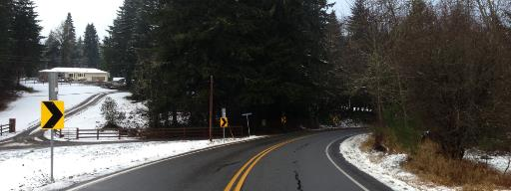
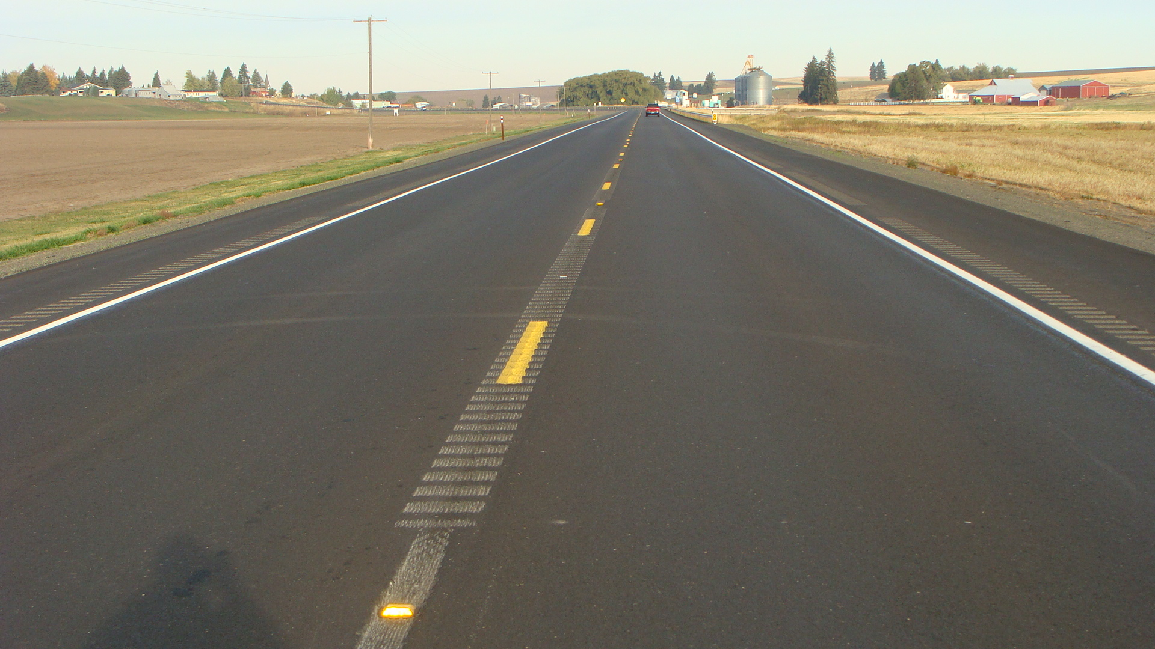
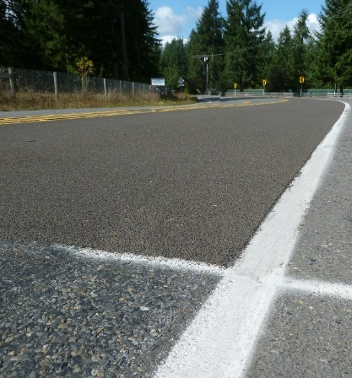
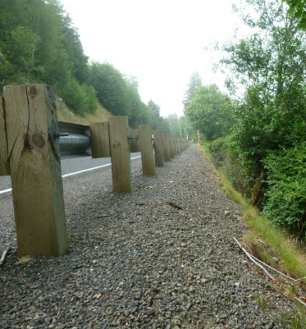
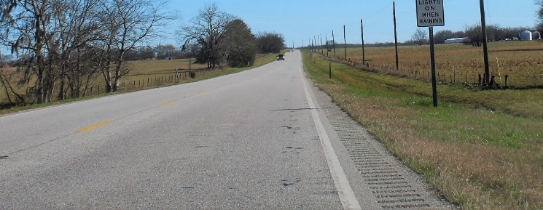
Systemic Approach: Select Countermeasures
  Assemble comprehensive list of countermeasures.
  Evaluate/screen countermeasures.
  Select countermeasures for deployment.
Chevrons
Rumble Strips
Barriers
Clear Zones
High Friction Surface Treatments
All photos source: FHWA.

Slide 77

FHWA FCFT Report: Six-Step Countermeasure Selection
Step 1. Identify focus crash type.
Step 2. Identify contributing factors for focus crash type.
Step 3. Assemble list of potential countermeasures that address the crash type.
Step 4. Identify countermeasures that address the contributing factors associated with the focus crash type.
Step 5. Identify countermeasures with CMFs.
Step 6. Select countermeasure.

Slide 78

FHWA FCFT Report: Six-Step Countermeasure Selection
Step 1. Identify focus crash type:
  Select the focus crash type according to the priorities of the transportation agency (e.g., outlined in SHSP).
  Define focus crash type by:
    Type of maneuver (e.g., ROR).
    Time of day (day versus night).
    Type of segment (curve versus tangent) or type of intersection
    (e.g., four-leg signalized).

Slide 79

FHWA FCFT Report: Six-Step Countermeasure Selection
Step 2. Identify contributing factors for focus crash type. Some factors may be expected to increase a particular crash type: e.g., ROR crashes on curves during the daytime:
      Percent grade (as grade increases, crash potential increases).
      Average shoulder width (as shoulder width increases, crash
      potential decreases).

Slide 80

FHWA FCFT Report: Six-Step Countermeasure Selection
Step 3. Assemble list of potential countermeasures that address the crash type. Resources may include:
    National Cooperative Highway Research Program (NCHRP) Report 500 Series.⁽¹¹⁾
    Highway Safety Manual.⁽¹²⁾
    FHWA CMF Clearinghouse.⁽¹³⁾
    FHWA Proven Safety Countermeasures list.⁽¹⁴⁾
    NHTSA Countermeasures That Work.⁽¹⁵⁾
    FWHA PedSafe.⁽¹⁶⁾
    FWHA BikeSafe.⁽¹⁷⁾
    State-generated list of common countermeasures within a State (i.e., “toolbox”).

Slide 81
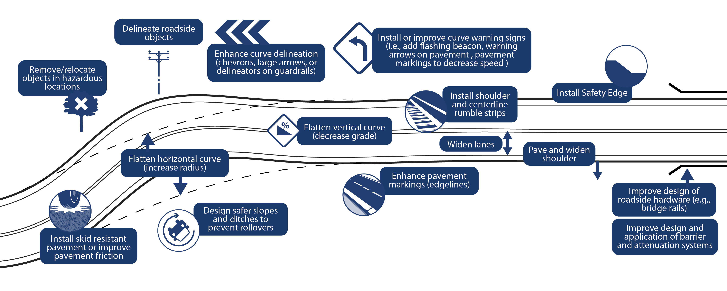
FHWA FCFT Report: Six-Step Countermeasure Selection
Source: FHWA.

Slide 82

FHWA FCFT Report: Six-Step Countermeasure Selection
Step 4. Identify countermeasures that address the contributing factors associated with the focus crash type:
  Compare the information known about each countermeasure on the
  list from step 3 to the contributing factors identified in step 2.
  Identify those countermeasures that specifically address one or
  more of the contributing factors.

Slide 83
FHWA FCFT Report: Six-Step Countermeasure Selection
Countermeasure | Factor 1: Percent Grade | Factor 2: Average Shoulder Width
Install shoulder and/or centerline rumble strips
Widen lanes
Enhance curve delineation (chevrons, large arrows, or delineators on guardrails)
Install or improve curve warning signs (i.e., add flashing beacon)
Install warning arrows on pavement prior to curve
Install pavement markings to decrease speed prior to curve
Flatten horizontal curve (increase radius)
Flatten vertical curve (decrease grade) | ✓
Enhance pavement markings (edge lines)
Install skid-resistant pavement or improve pavement friction
Widen and/or pave shoulder |  | ✓
Install safety edge
Design safer slopes and ditches to prevent rollovers
Remove/relocate objects in hazardous locations
Delineate roadside objects
Improve design of roadside hardware (e.g., bridge rails)
Improve design and application of barrier and attenuation systems
Source: FHWA.⁽¹⁾
✓ = countermeasure directly addresses risk factor.

Slide 84

FHWA FCFT Report: Six-Step Countermeasure Selection
Step 5. Identify countermeasures with CMFs.
Resources may include:
    CMF Clearinghouse.⁽¹³⁾
    State CMF list.

Slide 85
FHWA FCFT Report: Six-Step Countermeasure Selection
Countermeasure | Factor 1: Percent Grade | Factor 2: Average Shoulder Width | CMF Available
Install shoulder and/or centerline rumble strips |  |  | ✓
Widen lanes |  |  | ✓
Enhance curve delineation (chevrons, large arrows, or delineators on guardrails) |  |  | ✓
Install or improve curve warning signs (i.e., add flashing beacon) |  |  | ✓
Install warning arrows on pavement prior to curve |  |  | ✓
Install pavement markings to decrease speed prior to curve
Flatten horizontal curve (increase radius)
Flatten vertical curve (decrease grade) | ✓ |  | ✓
Enhance pavement markings (edge lines) |  |  | ✓
Install skid-resistant pavement or improve pavement friction |  |  | ✓
Widen and/or pave shoulder |  | ✓ | ✓
Install safety edge |  |  | ✓
Design safer slopes and ditches to prevent rollovers |  |  | ✓
Remove/relocate objects in hazardous locations |  |  | ✓
Delineate roadside objects
Improve design of roadside hardware (e.g., bridge rails)
Improve design and application of barrier and attenuation systems |  |  | ✓
Source: FHWA.⁽¹⁾
✓ = countermeasure directly addresses risk factor; CMF for countermeasure available.

Slide 86

FHWA FCFT Report: Six-Step Countermeasure Selection
Step 6. Select countermeasure. Select from the pool of eligible countermeasures generated in step 3.

Slide 87
FHWA FCFT Quick Reference Guide: Countermeasures for Non-Intersection
Countermeasure | Contributing Factor
 | Larger Percent Grade | Narrower Lane Width | Narrower Paved Surface Width | Narrower Shoulder Width | Unpaved Shoulder | Higher Speed Limit | Mountainous Terrain | Smaller Curve Radius
Safety edge | ✓ | ✓ | ✓ | ✓ | ✓ | ✓ |  | ✓
Rumble strips/stripes |  | ✓ | ✓ | ✓ | ✓ | ✓ | ✓ | ✓
Enhanced friction for horizontal curves | ✓ |  | ✓ |  |  | ✓ |  | ✓
Enhanced delineation for horizontal curves |  |  | ✓ |  |  | ✓ |  | ✓
Roadside design improvements at curves |  |  |  |  |  | ✓ |  | ✓
Advance markings for curves |  | ✓ | ✓ | ✓ | ✓ | ✓ |  | ✓
Advance signs |  | ✓ | ✓ | ✓ |  | ✓ | ✓ | ✓
Source: FHWA.⁽²⁾
✓ = countermeasure directly addresses risk factor.

Slide 88
FHWA FCFT Quick Reference Guide: Countermeasures for Intersection
Countermeasure | Contributing Factor | Contributing Factor
 | Smaller Curve Radius (for Intersection on Curve) | Wider Mainline Lane Width | Wider Mainline Median Width | Absence of Mainline Left Turn Channelization | Absence of Minor Street Right Turn Channelization (Signalized Intersections) | Higher Speed Limit/Design Speed
Left- and right-turn lanes |  |  |  | ✓ | ✓ | ✓
Yellow change intervals |  |  |  |  |  | ✓
Backplates with retroreflective borders |  | ✓ | ✓ |  |  | ✓
Application of multiple low-cost countermeasures | ✓ | ✓ | ✓ | ✓ | ✓ | ✓
Advance signs | ✓ | ✓ | ✓ |  |  | ✓
Source: FHWA.⁽²⁾
✓ = countermeasure directly addresses risk factor.

Slide 89
Countermeasure Selection:
Additional Resources
Systemic Project Selection Tool.⁽⁵⁾
Proven Safety Countermeasures list.⁽¹⁴⁾
CMF Clearinghouse.⁽¹³⁾
Pedestrian Safety Guide and Countermeasure Selection System.⁽¹⁶⁾
NCHRP 500 Series.⁽¹¹⁾
Reliability of Safety Management Methods: Countermeasure selection.⁽¹⁸⁾
Highway Safety Manual (Part D).⁽¹²⁾
NHTSA’s Countermeasures That Work.⁽¹⁵⁾

Slide 90

FHWA FCFT Report: Summary
Main goal—Inform applications of systemic safety improvements by identifying:
  Focus crash types.
  Focus facility types.
  Associated contributing factors.
Scope—There are three main technical tasks:
  Identify FCFTs—17 FCFTs (9 non-intersection and 8 intersection FCFTs).
  Identify contributing factors associated with the FCFTs.
  Develop a process to select countermeasures.
Source: FHWA.

Slide 91
FHWA FCFT Report: Conclusions, Recommendations
Identifying FCFTs and risk factors:
  Agency with sufficient data and analysis capability:
    Develop agency-specific list of FCFTs.
    Identify risk factors.
  Agency with limited data and analysis capability:
    Refer to SHSP for focus crash types.
    Refer to the FCFT list and risk factors developed from the research.
Source: FHWA.

Slide 92
FHWA FCFT Report: Conclusions, Recommendations
Using random forest to identify contributing factors, there is a limited ability to interpret the direction and form a relationship:
    This research: Simple approach looking for linear trend.
    Recommendation for future work: Exploring more effective ways to uncover the relationship.
Identifying contributing factors using the Bayesian approach shows significant potential—Causal Bayesian networks.
Source: FHWA.

Slide 93
FHWA FCFT Report: Conclusions, Recommendations
Considering socioeconomic and weather factors:
  Potential for supporting informed decisions.
  Not enough theory to support or refute the results.
  More work in this area possibly needed.
Source: FHWA.

Slide 94
Discussion
Source: FHWA.

Slide 95
Polling Question
Q8
Source: FHWA.
What is one takeaway from today’s presentation that you can use in your agency?
Notes:
Insert before summary slide
What is one takeaway, from today’s presentation, that you can use in your agency?
-Open response

Slide 96
References
¹ Saleem T., R. Porter, R. Srinivasan, D. Carter, S. Himes, and T. Le. 2020. Contributing Factors for Focus Crash and Facility Types. Report No. FHWA-HRT-20-052. Washington, DC: Federal Highway Administration. https://www.fhwa.dot.gov/publications/research/safety/20052/index.cfm, last accessed October 21, 2021.
² Porter, R., T. Le, F. Gross, D. Carter, Saleem T., and R. Srinivasan. 2020. Contributing Factors for Focus Crash and Facility Types: Quick Reference Guide. Report No. FHWA-HRT-20-053. Washington, DC: Federal Highway Administration. https://www.fhwa.dot.gov/publications/research/safety/20053/20053.pdf, last accessed October 28, 2021.
³ Donnell E., E. Hanks, R. J. Porter, L. Cook, R. Srinivasan, F. Li, M. Nguyen, and K. Eccles. The Development of Crash Modification Factors: Highway Safety Statistical Paper Synthesis. Report No. FHWA-HRT-20-069. Washington, DC: Federal Highway Administration. https://www.fhwa.dot.gov/publications/research/safety/20069/index.cfm, last accessed October 21, 2021.
⁴ FHWA. 2016. Electronic Code of Federal Regulations. 23 CFR §924.3 Definitions.
⁵ Preston, H., R. Storm, J. D. Bennett, and B. Wemple. 2013. Systemic Safety Project Selection Tool. Report No. FHWA-SA-13-019. Washington, DC: Federal Highway Administration. https://safety.fhwa.dot.gov/systemic/fhwasa13019/, last accessed October 21, 2021.
⁶ NHTSA. 2018. “Fatality Analysis Reporting System (FARS)” (website). https://www.nhtsa.gov/research-data/fatality-analysis-reporting-system-fars, last accessed January 19, 2018.
⁷ FHWA. n.d. “HSIS” (website). https://www.hsisinfo.org/, last accessed October 21, 2121.
⁸ R Core Team. 2014. R: A language and environment for statistical computing (software). Vienna, Austria: R Foundation for Statistical Computing. http://www.R-project.org/, last accessed October 28, 2021
⁹ Barrowman, N., S. Gatscha, and F. Momoli. 2021. vtree: Display Information About Nested Subsets of a Data Frame (software). https://CRAN.R-project.org/package=vtree, last accessed October 28, 2021.

Slide 97
References
¹⁰ Breiman, L., A. Cutler, A. Liaw, and M. Wiener. 2018. randomForest: Breiman and Cutler's Random Forests for Classification and Regression (software). https://CRAN.R-project.org/package=randomForest , last accessed October 28, 2021.
¹¹ NCHRP. 2003–2009. “NCHRP Report 500: Guidance for Implementation of the AASHTO Strategic Highway Safety Plan” (website). https://www.trb.org/Main/Blurbs/152868.aspx, last accessed October 28, 2021.
¹² AASHTO. 2010. Highway Safety Manual. Washington, DC: American Association of State Highway and Transportation Officials. http://www.highwaysafetymanual.org/Pages/default.aspx, last accessed October 21, 2021.
¹³ FHWA. 2018. “CMF Clearinghouse. 2018” (website). http://www.cmfclearinghouse.org, last accessed October 21, 2021.
¹⁴ FHWA. 2017. “Proven Safety Countermeasures” (website). https://safety.fhwa.dot.gov/provencountermeasures, last accessed October 21, 2021.
¹⁵ Goodwin, A., B. Kirley, L. Sandt, W. Hall, L. Thomas, N. O’Brien, and D. Summerlin. 2013. Countermeasures That Work: A Highway Safety Countermeasure Guide for State Highway Safety Offices, Seventh Edition. Report No. DOT-HS-811-727. Washington, DC: National Highway Traffic Safety Administration. http://www.nhtsa.gov/staticfiles/nti/pdf/811727.pdf, last accessed October 21, 2021.
¹⁶ FHWA. 2018. “PEDSAFE: Pedestrian Safety Guide and Countermeasure Selection System” (website). http://www.pedbikesafe.org/PEDSAFE, last accessed October 21, 2021.
¹⁷ FHWA. 2018. “BIKESAFE: Bicycle Safety Guide and Countermeasure Selection System” (website). http://www.pedbikesafe.org/bikesafe, last accessed October 21, 2021.
¹⁸ Gross, F., T. Harmon, G. Bahar, and K. Peach. 2016. Reliability of Safety Management Methods: Systemic Safety Programs. Report No. FHWA-SA-16-041. Washington, DC: Federal Highway Administration. https://safety.fhwa.dot.gov/rsdp/downloads/fhwasa16041.pdf, last accessed October 28, 2021.

Slide 98
Contacts
Roya Amjadi
Roya.Amjadi@dot.gov
Office of Safety Research Development, Federal Highway Administration

